Slide 1
SLSS
April 2026
Parent-Teacher Conferences
Instructions

Slide 2
Details
Conference slots are 10 minutes
Parents should only book with a teacher for 1 time slot. If more time is needed, please connect with the teacher to schedule.
Parents will receive an email confirmation after booking appointment.
Reminder emails will be sent 1 day prior to the appointment.
Parents will receive an email reminder with a summary of booking
Bookings will be unavailable 24 hours prior to the start of each conference time slot.

Slide 3
April 29 & 30 Conferences (IN-PERSON)
Conferences on Apr. 29th are available from 2-4pm.
Conferences on Apr. 30th are from 2-4pm & 6-8pm.
In-person conferences are 10-minutes long and will take place in a designated classroom or space.

Slide 4
How to book an appointment
Visit:
The SLSS PT Booking Site for Apr. 29 & 30
HERE
Site closes for all bookings at 12:00pm on Tuesday, Apr. 28th.

Slide 5
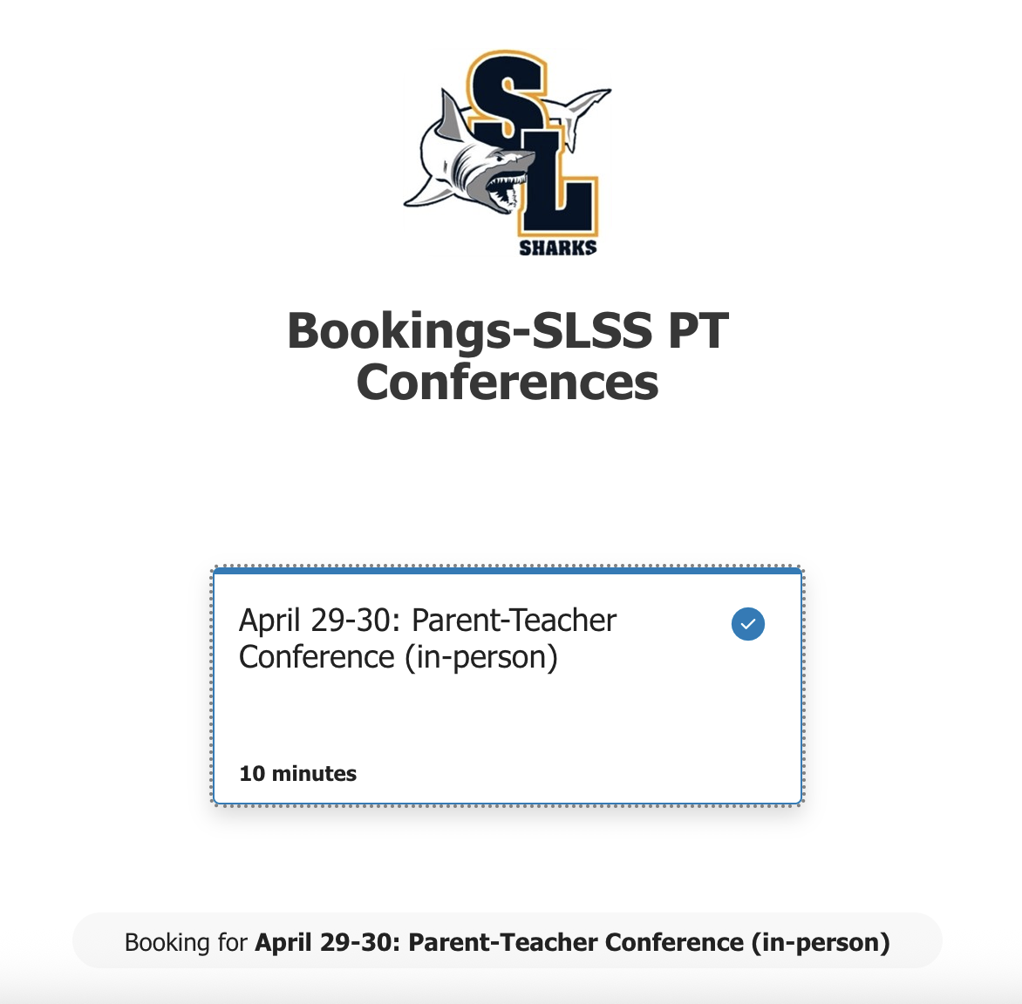
1) LINK to booking site.

Slide 6
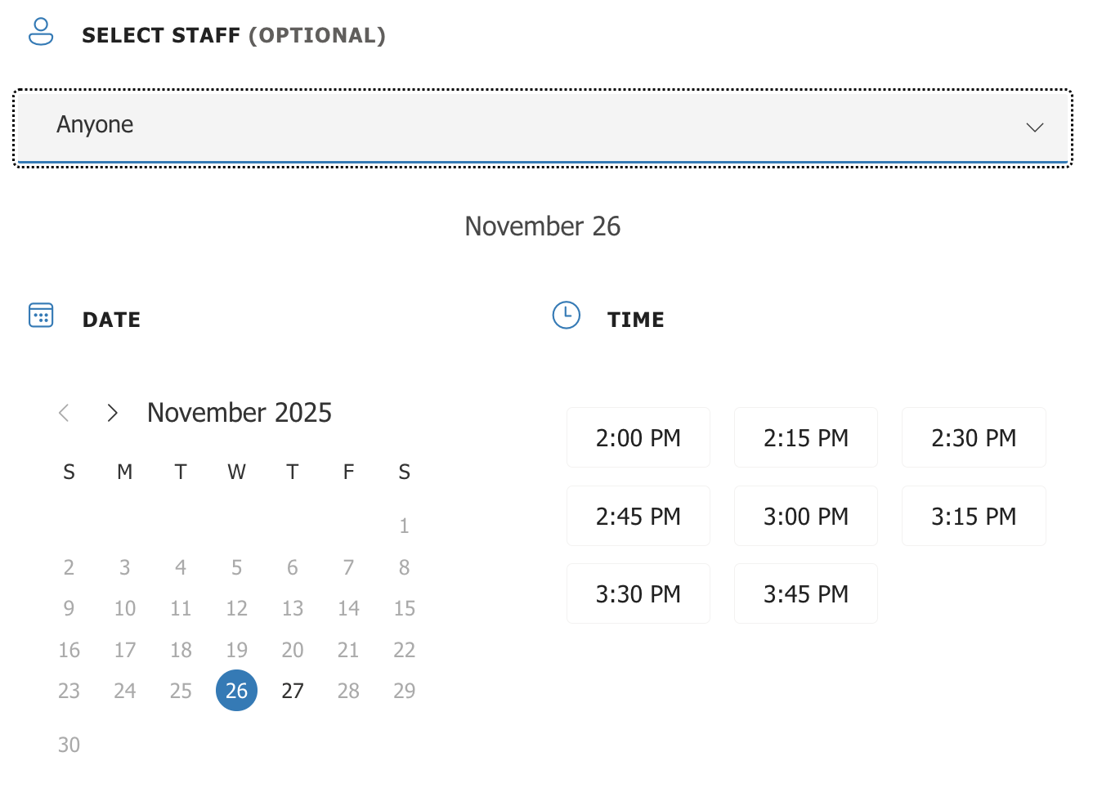
2) Scroll down…Select date
IMPORTANT
NOT OPTIONAL
Use this drop-down to select the teacher.

Slide 7
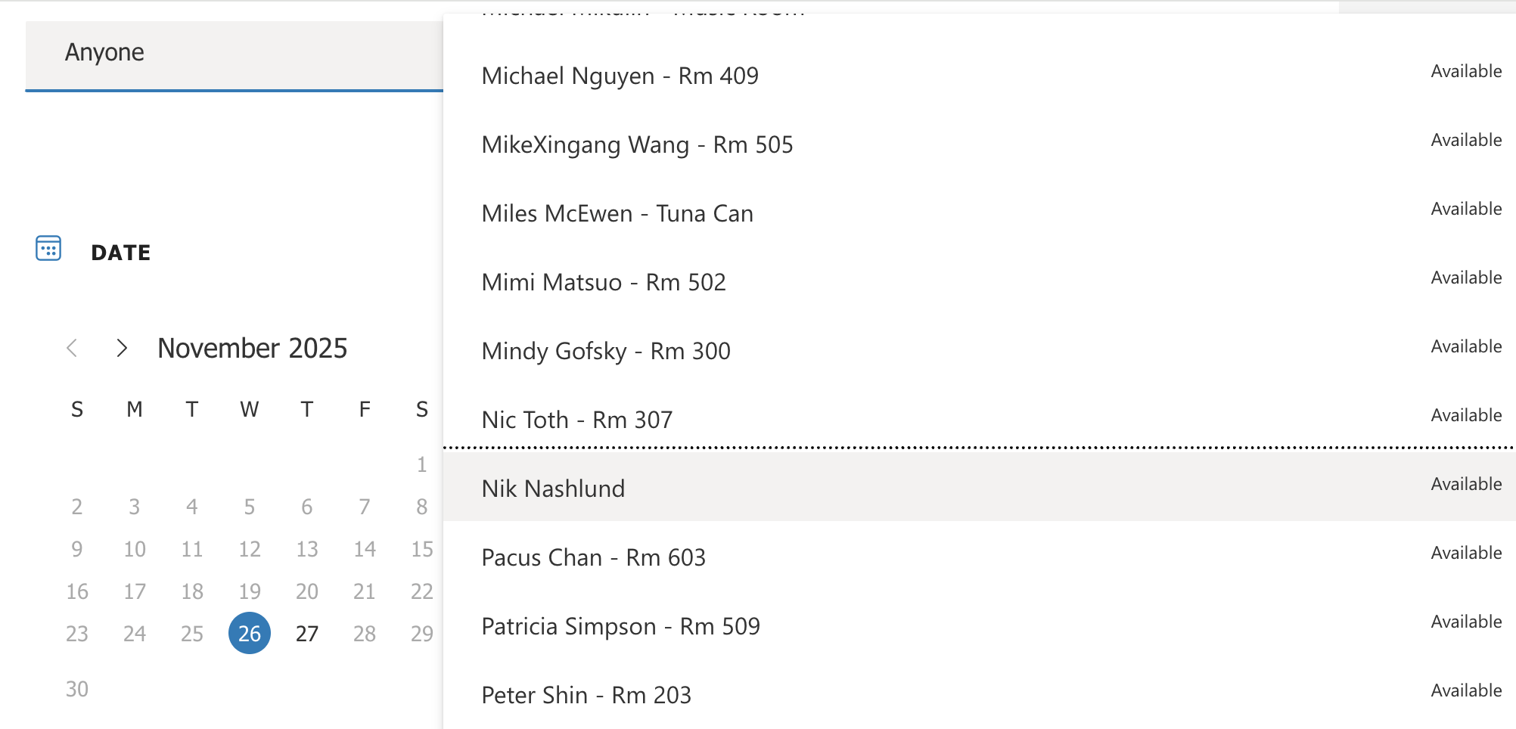
3) Select Teacher from drop down menu

Slide 8
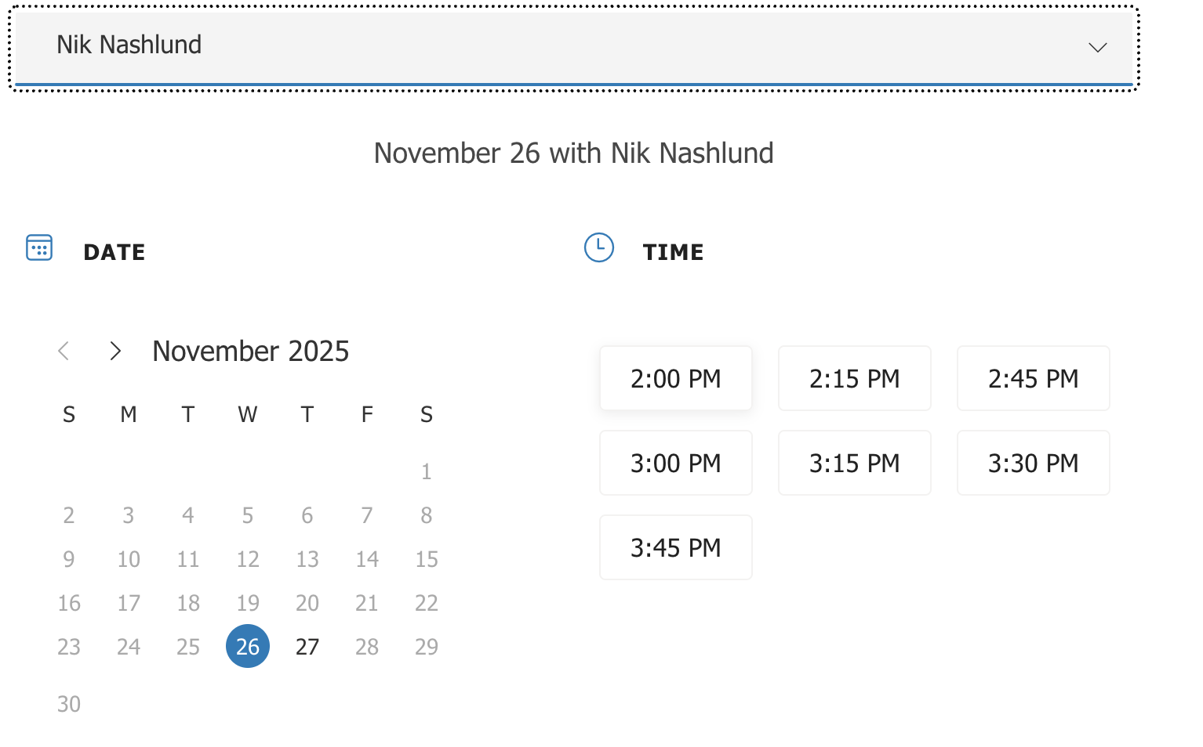
4) Select Time
Only times that are available will appear here.
Select 1 time slot ONLY.

Slide 9
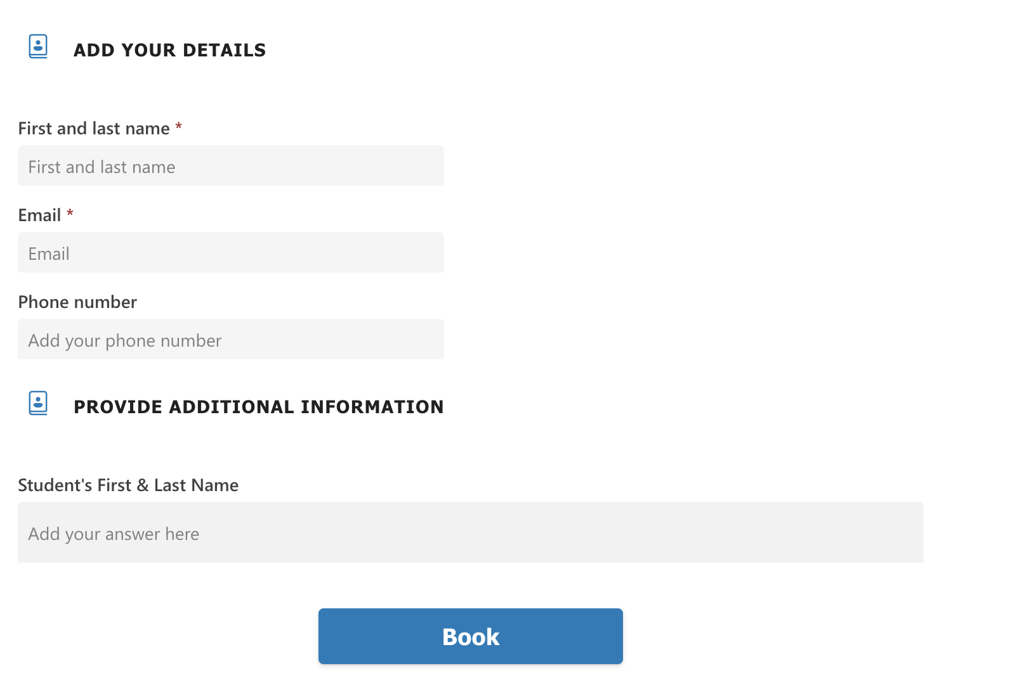
5) Enter Information
Parent Contact Information
Enter your student’s Usual Name
CLICK BOOK TO SUBMIT

Slide 10
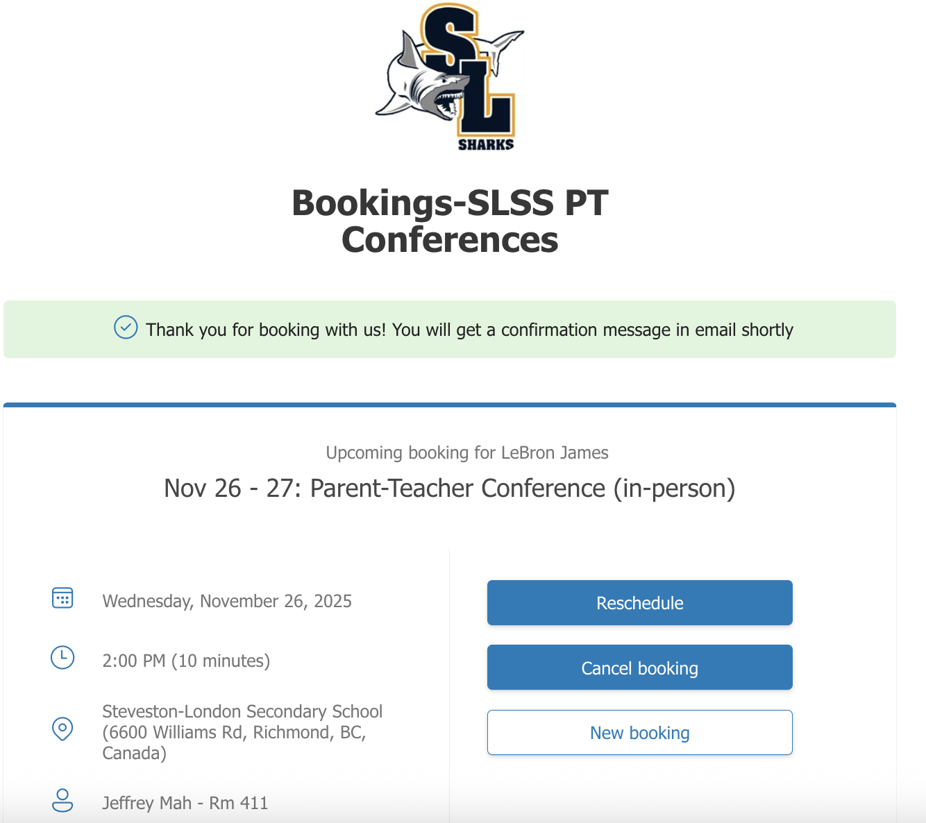
Booking Complete.
Click to Reschedule
Click to Cancel
Click to book another appointment

Slide 11
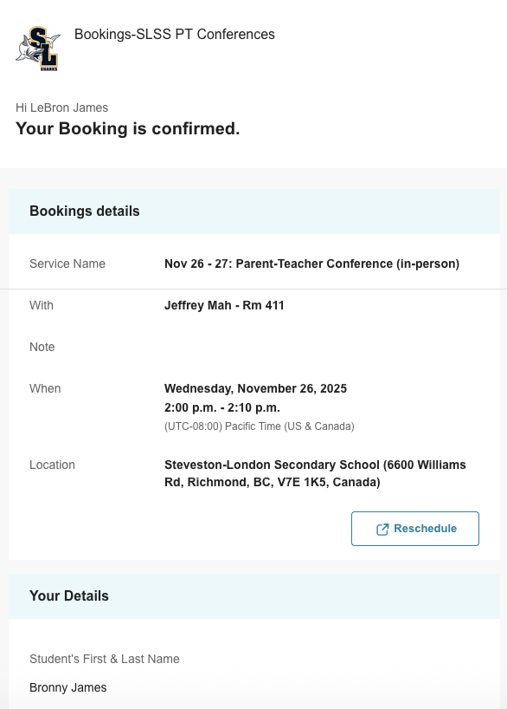
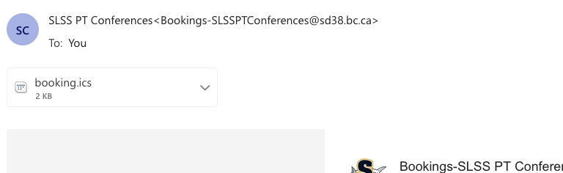
Booking Confirmation
After booking your appointment, you will receive a confirmation email with the details shown here.
If you need to reschedule an appointment, please use the ‘reschedule’ button at the bottom of the email.
  You will not be permitted to reschedule an appointment within 24 hours of the start of each appointment.
Parents will receive a booking summary via email, 1 day prior to the appointment day with a summarized list of all appointments.
Use the .ics file to add to your own calendar!
Click to Reschedule

Slide 12
Support
Please refer to this guide for support.
If you have any questions or concerns, please contact SLSS at
steveston-london@sd38.bc.ca or 604-668-6668.

