Slide 1














SLSS
Course Programming
Grade 8s going into grade 9 2026-2027

Slide 2
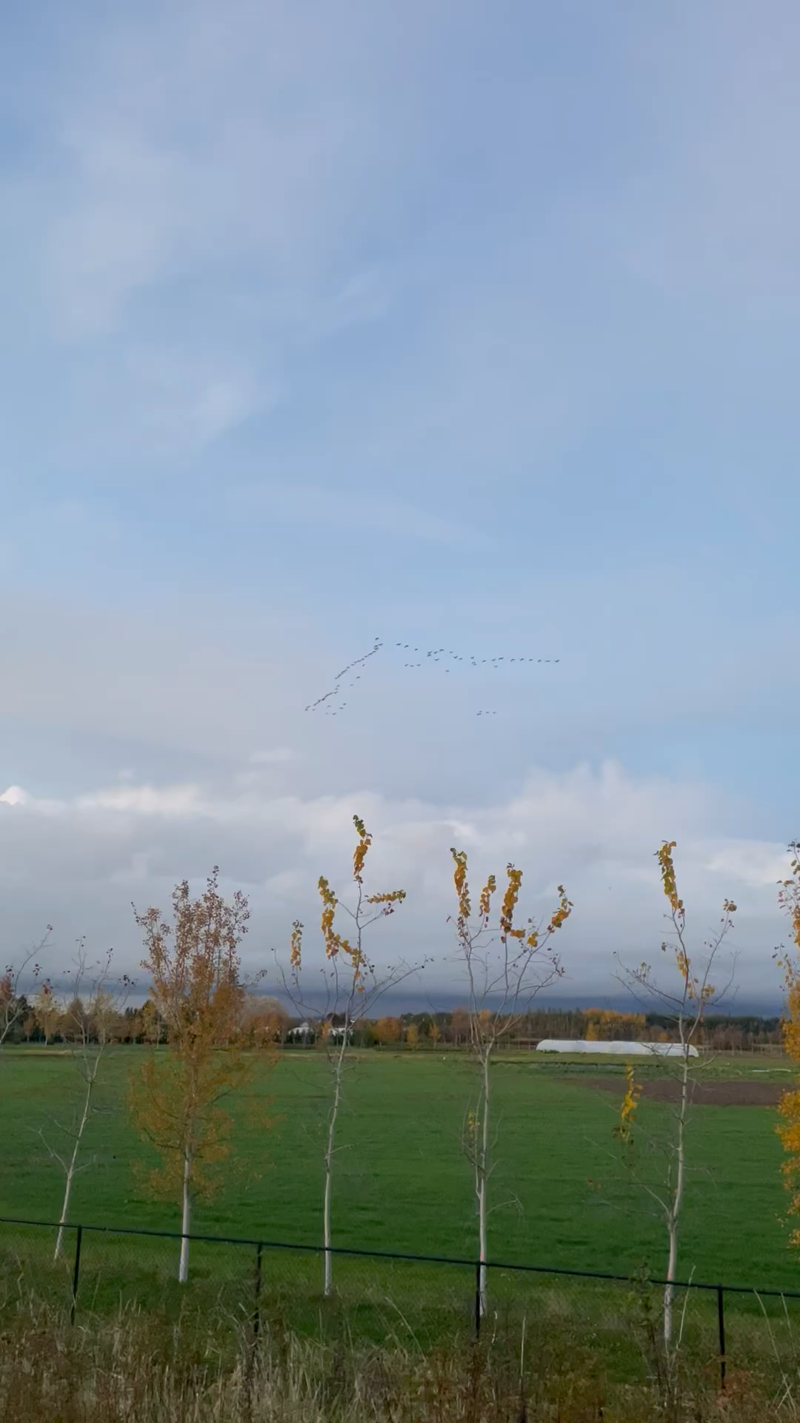
Land
Acknowledgement
We acknowledge that we are on the traditional, ancestral, and unceded territory of the people of the hən̓q̓əmin̓əm̓ language group, and we thank those who have occupied and cared for this land for thousands of years.
Notes:
Anytime that I begin what I think is an important meeting, I always want to begin by acknowledging territory

Slide 3


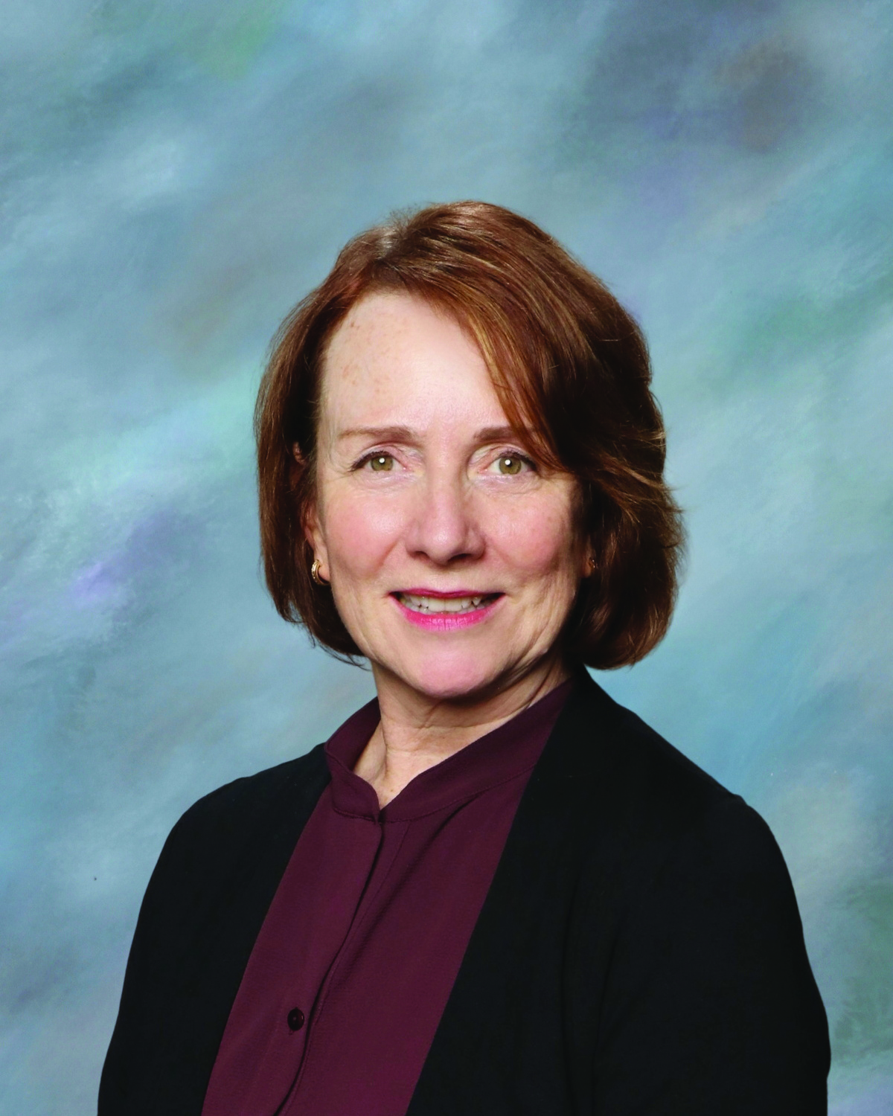
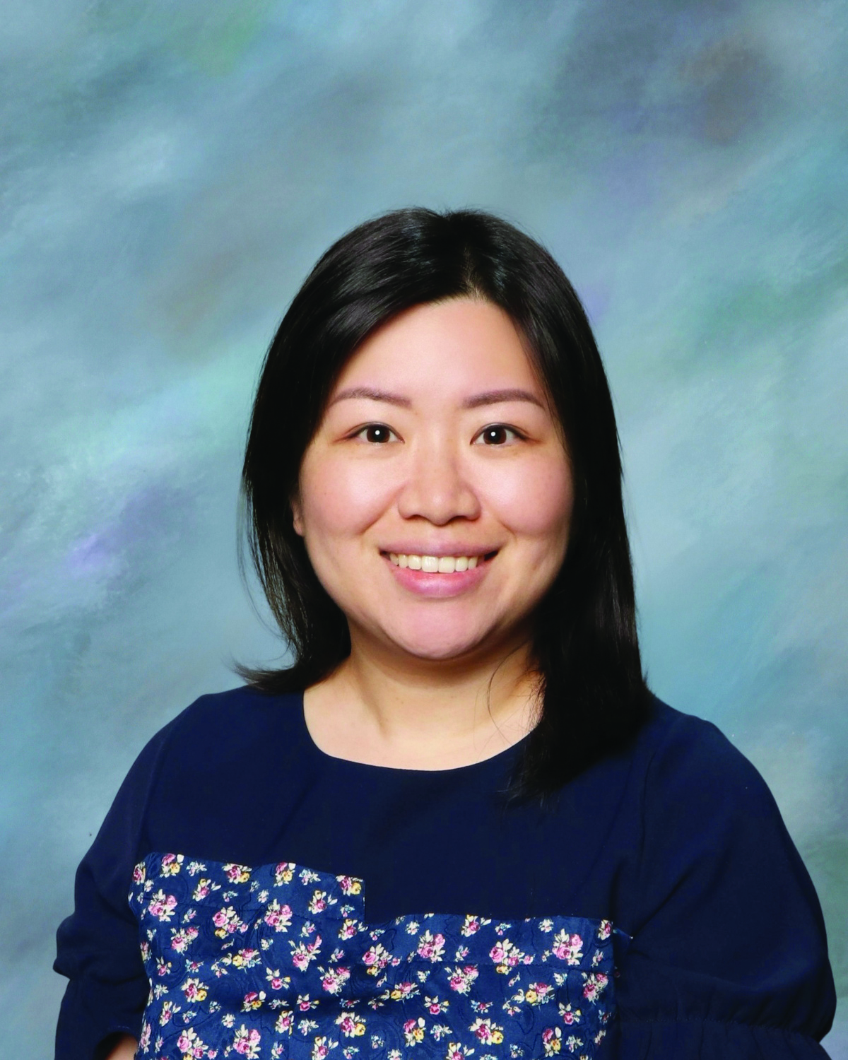

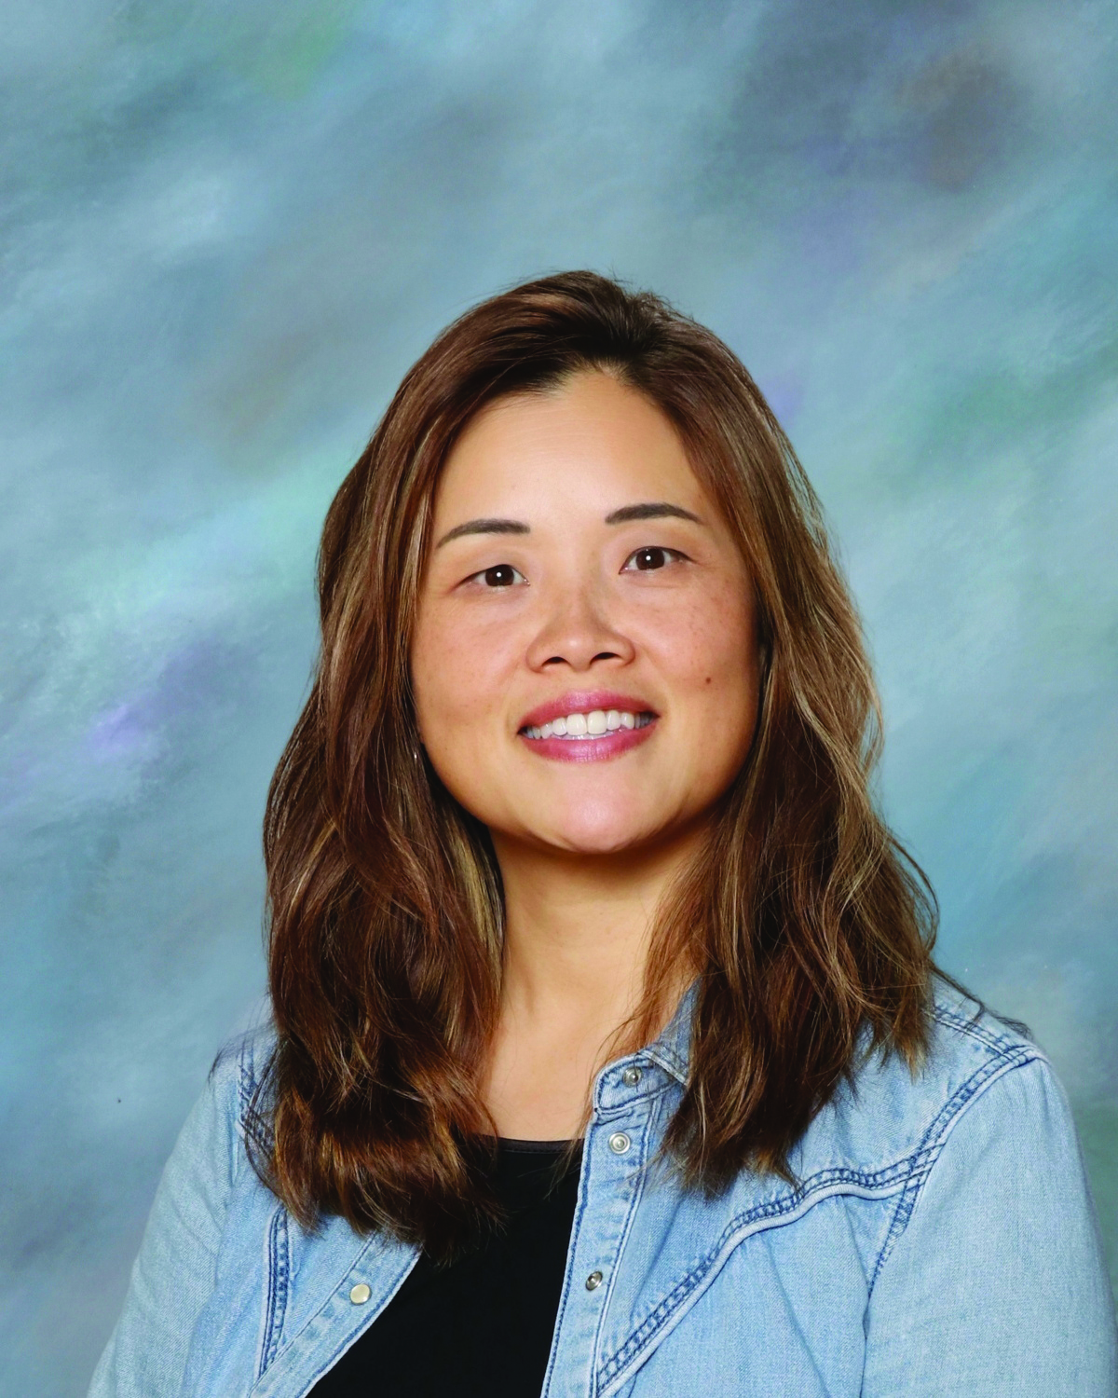
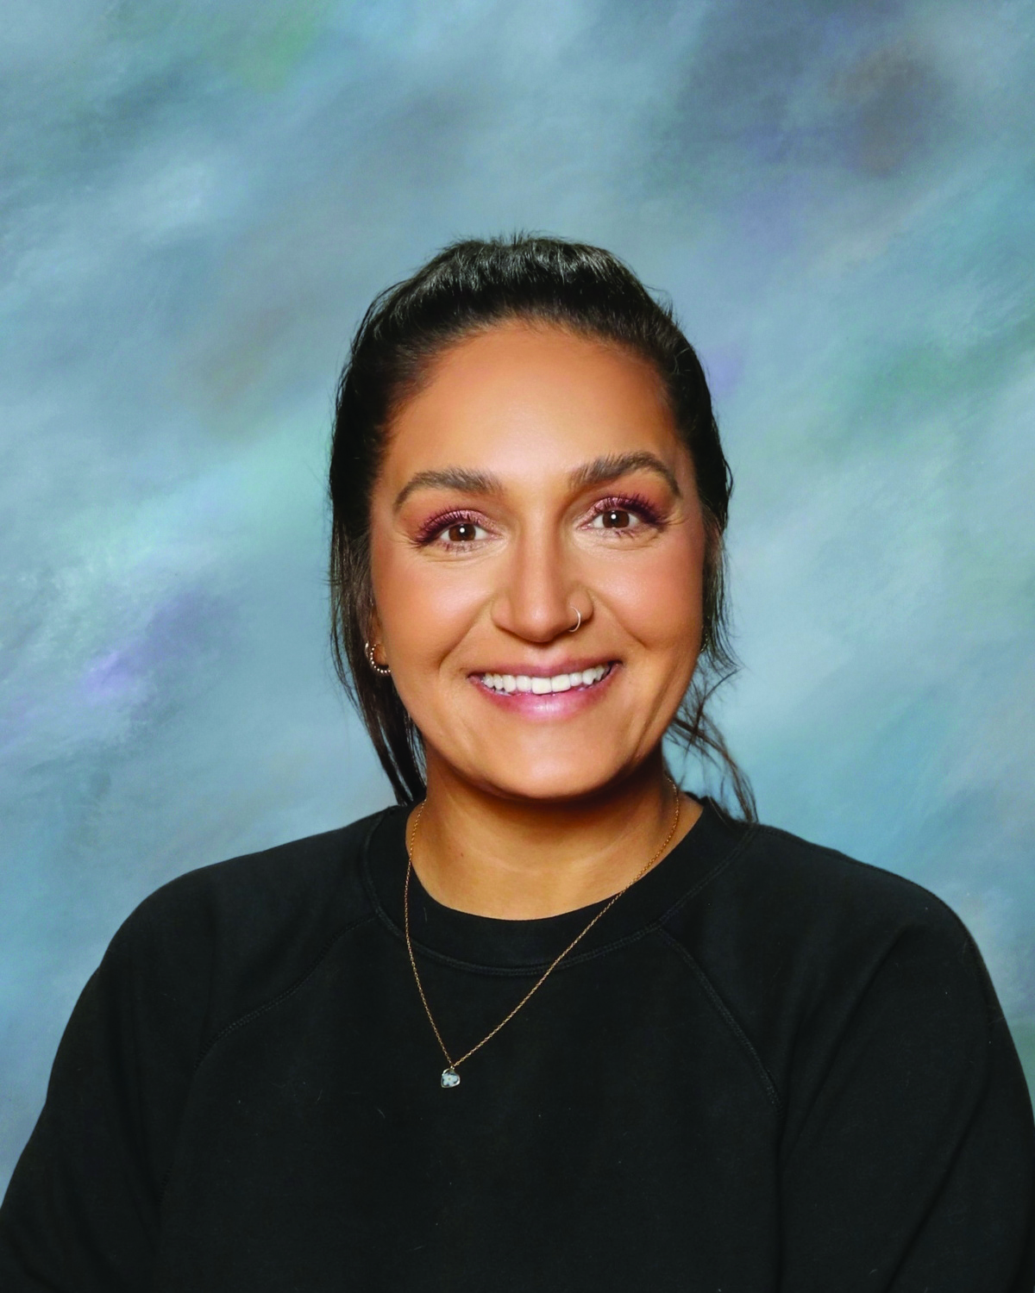
COUNSELLING DEPARTMENT/TEAM
Ms. Ratcliffe
Ms. Lau
Ms. Ioannidis
Ms. Zee
Ms. Sihota
A, X- Z & International
P - W
B - G
H - J
K - O

Slide 4
What is the purpose of this assembly?
To understand the course selection process at SLSS
Gain an understanding of what graduation means/looks like/when graduation pathway starts
Learn where to find the courses being offered at SLSS
How to select your courses

Slide 5
SCHOOL:
A large number of fish or aquatic animals of one kind swimming together.
Notes:
Emphasize that you’re all learning together. School is supposed to be fun, you are here to try and learn new things and explore your interests

Slide 6

What does grade 9 look like?
Required Courses:
Elective Courses x 3
English Language Arts 9
Math 9
Science 9
Social Studies 9
Physical & Health
Education 9
Your elective courses can be a grade 9 or 10 level course. They can be from the Fine Arts, ADST, or Modern Languages departments.
Notes:
Explain what required means.

Slide 7
REQUIRED VS. ELECTIVE COURSES
Required Courses:
Elective Courses x 3
Courses that you can take to explore your interests or skillset or that you would have never thought of taking.
Courses that are needed to prepare you for your grad required courses starting in grade 10.
Grade 9
Grade 10
Grade 11
Grade 12
5 required
3 electives
6 required
2 elective
3 required
5 electives
1 required
7 electives

Slide 8
What elective courses are in each departments?
examples
Fine Arts or Performing Arts
Applied, Design, Skills &
Technology (ADST):
ADST : Home Economics
Languages:
Textiles
Foods
Meal prep program (senior)
Fashion Design (senior)
Mandarin
Japanese
Spanish
French
2D Art
3D Art
Theatre Performance
Vocal Ensemble
Band
Woodworking
Metal Design
Computer Studies
Entrepreneurship
Media Design (senior)
*Please ensure you check all of the courses available to grade 9 students in the program guide.

Slide 9
What does grade 9 look like?
Required Courses:
Elective Courses x 3
English Language Arts 9
Math 9
Science 9
Social Studies 9
Physical & Health
Education 9
1. Spanish 9
2. Metal Design Level 1 (10)
3. Marketing & ENT (10)
*Ministry encourages students to take a variety of courses from all departments.
Notes:
The reason why we encourage students to take a course from every department is to experience courses and activities that you would never have access to outside of a school environment to challenge yourself and learn new things. You’re not expected to know how to do certain things before entering the class. The class is supposed to TEACH you how

Slide 10
Required Courses
Elective Courses
PATH TO GRADUATE STARTS WITH GRADE 10 LEVEL COURSES
TOTAL OF 80 grade 10-12 CREDITS (4 credits per course)

Slide 11
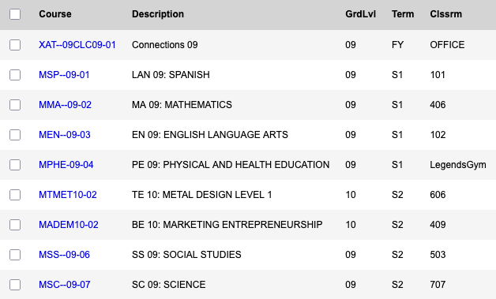
Example of a grade 9 student schedule
Notes:
You’ll notice that this grade 9 student has 2 grade 10 courses. This is okay. I’ll share why in just a minute

Slide 12
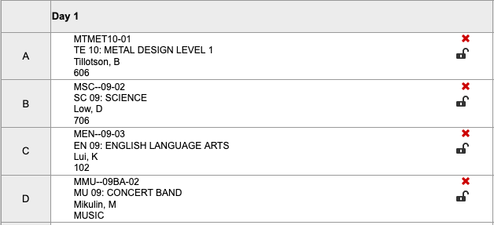
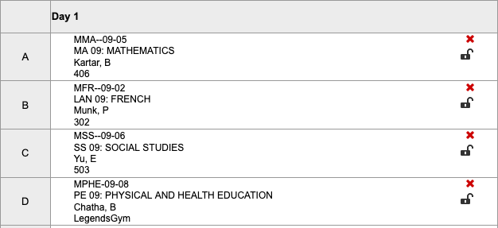
Semester 1
Semester 2

Slide 13
Example of a grade 9 student schedule
Notes:
You’ll notice that this grade 9 student has 2 grade 10 courses. This is okay. I’ll share why in just a minute

Slide 14


Slide 16
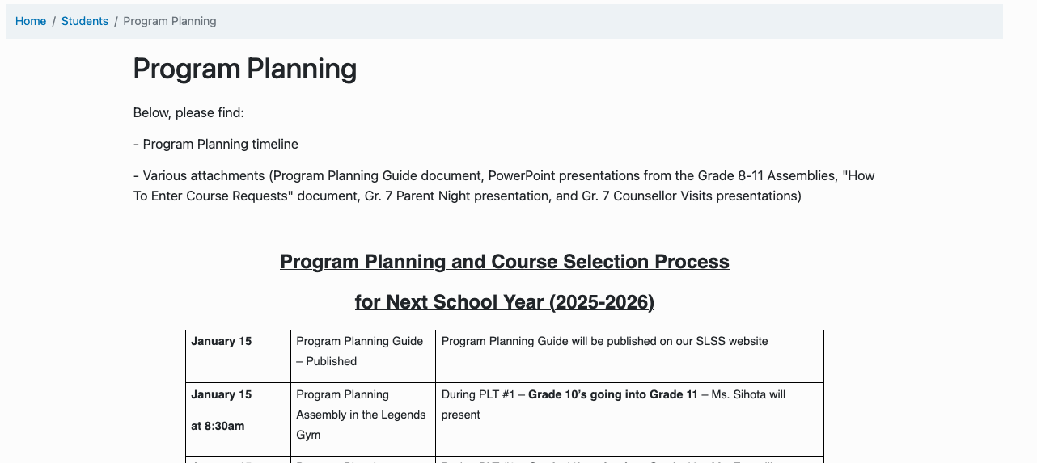
How do I CHOOSE my elective courses?
Notes:
https://slss.sd38.bc.ca/files/slss/2026-01/Program%20Planning%20Guide%20Final%20Version%20%28January%206%2C%202026%29.pdf
Page 21 *Reminder of what is required

Slide 17
COURSE SELECTIONS
Make sure you have the right required courses.
It is important that you choose your courses carefully
Schools are staffed and timetable is built according to the courses chosen by students
Students with incomplete timetables or legitimate course errors will be prioritized for course corrections
Valid Course Corrections
You are registered in a course that you passed the previous year
You are registered in a course that you passed in Summer School
You have less than 8 courses
You are taking a course online
You have two of the same courses in
your schedule
Notes:
The reason why we encourage students to take a course from every department is to experience courses and activities that you would never have access to outside of a school environment to challenge yourself and learn new things. You’re not expected to know how to do certain things before entering the class. The class is supposed to TEACH you how

Slide 18
How do I choose my elective courses?
ART | BUSINESS | PERFORMING ARTS | HOME ECONOMICS | MUSIC | TECH ED | LANGUAGES
ART STUDIO 9 | COMPUTER STUDIES 10 | DRAMA 9 | FOOD STUDIES LEVEL 1 (10) | CONCERT BAND 9 | DRAFTING AND DESIGN LEVEL 1 (10) | FRENCH 9
CERAMICS & SCULPTURE 9 | MARKETING & ENTREPRENEURSHIP 10 |  | TEXTILES STUDIES LEVEL 1 (10) | GUITAR LEVEL 1 (10) | METAL DESIGN LEVEL 1 (10) | JAPANESE 9
DRAWING & PAINTING 9 |  |  |  | VOCAL ENSEMBLE 9 | WOODWORKING LEVEL 1 (10) | SPANISH 9
PHOTOGRAPHY 9 |  |  |  |  |  | MANDARIN 9
YEARBOOK 10
Notes:
https://slss.sd38.bc.ca/files/slss/2026-01/Program%20Planning%20Guide%20Final%20Version%20%28January%206%2C%202026%29.pdf
Page 21 *Reminder of what is required

Slide 19
Course Completion
You have plenty of time
You have 8 semesters total to complete your graduation requirements.
Some grade 9 students achieve grade 10 credit in grade 9 based on their elective course selection
Even if you don’t pick grade 10 courses in grade 9, you will still have lots of time to graduate.
Post-secondary schools/universities & colleges are not impressed by when you take a course, as long as they are complete.

Slide 20

IT’S NOT A RACE.

Slide 21
Languages
Not required but are VERY beneficial
Cognitive & brain benefits: Helps with memory, focus, problem solving
Career: Enhances career prospects, improves personal marketability
Personal & Social & Cultural: Can deepen cultural understanding, confidence while travelling

Slide 22

LANGUAGE PLACEMENT
For students who have not completed the Gr. 11 pre-requisite but have completed significant study in the target language outside of a regular SLSS class.
*must bring documentation of your learning (DELF certificates, Japanese and Chinese class report cards etc.
ASSESSMENT DATE: Thursday, Feb 5, 2026 during PLT
Mandarin
Japanese
French
Spanish
Ms. Gofsky
Room 300
Ms. Sybounmy
Room 400
Mme Munk
or Mme Lee
Room 302 or
Room 410
Ms. O’Neill
Room 101
Please sign up with the appropriate teacher on the PLT sign up page.
Notes:
The Modern Languages department will be conducting placement evaluations on ThursdayFebruary 5 during PLT time.
These evaluations are for students who have prior knowledge of a language, this may include taking outside language courses, living in a country where the language is spoken, or speaking the language at home. This is not for students who are taking regular language courses at Steveston-London.
Students should be prepared to complete a placement assessment or have a conversation with the teacher to determine their appropriate language level for next year.

Slide 23
NOT REQUIRED, BUT REALLY BENEFICIAL…

Slide 24
Summer School/Online Schools
Also known as continuing education
Summer school is not necessary for all students.
When students enter their graduation program (grade 10-12) and need to retake a course (failure, withdrew, etc..) summer school is a great option.
Summer school courses do not promise the next grade level course the following semester or year.
Courses are prioritized by those who require them for graduation or admissions requirements (seniors first)

Slide 25
NOT REQUIRED.
Enjoy your summer! Travel, participate in camps, learn how to navigate freedom, be a little “unscheduled”.

Slide 26
Communication
It’s important to communicate with your counsellor if you are participating in an online course or summer school.
Counsellors monitor your graduation pathway and courses.
Counsellors work with your teachers to help provide informed suggestions and guidance for your educational pathway.
Counsellors help ensure you are enrolled in the right courses each semester, every year.
We don’t want to schedule you into a course that you have already done.

Slide 27
STUDENTS MUST HAVE A FULL TIMETABLE

Slide 28
Semester 1
Semester 2

Slide 29
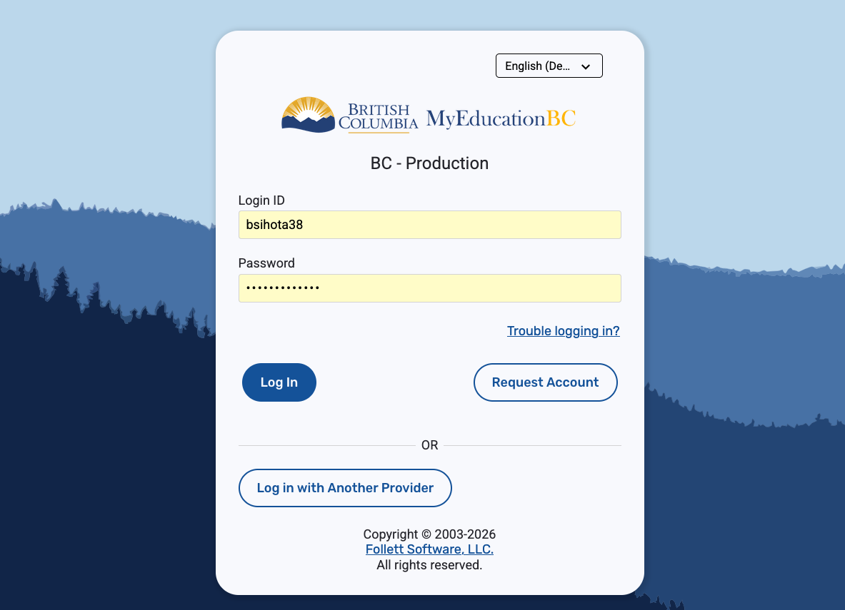
How do I SELECT my courses for next year?
Students will implement their courses requests into MyEducation BC.
Please ensure that you have logged into MyEd prior to course implementation days.
Make sure you know your username and password.
Check with the office if you do not know.
Notes:
Your MyEd login is different from your PLT, TEAM and locker username and password

Slide 30
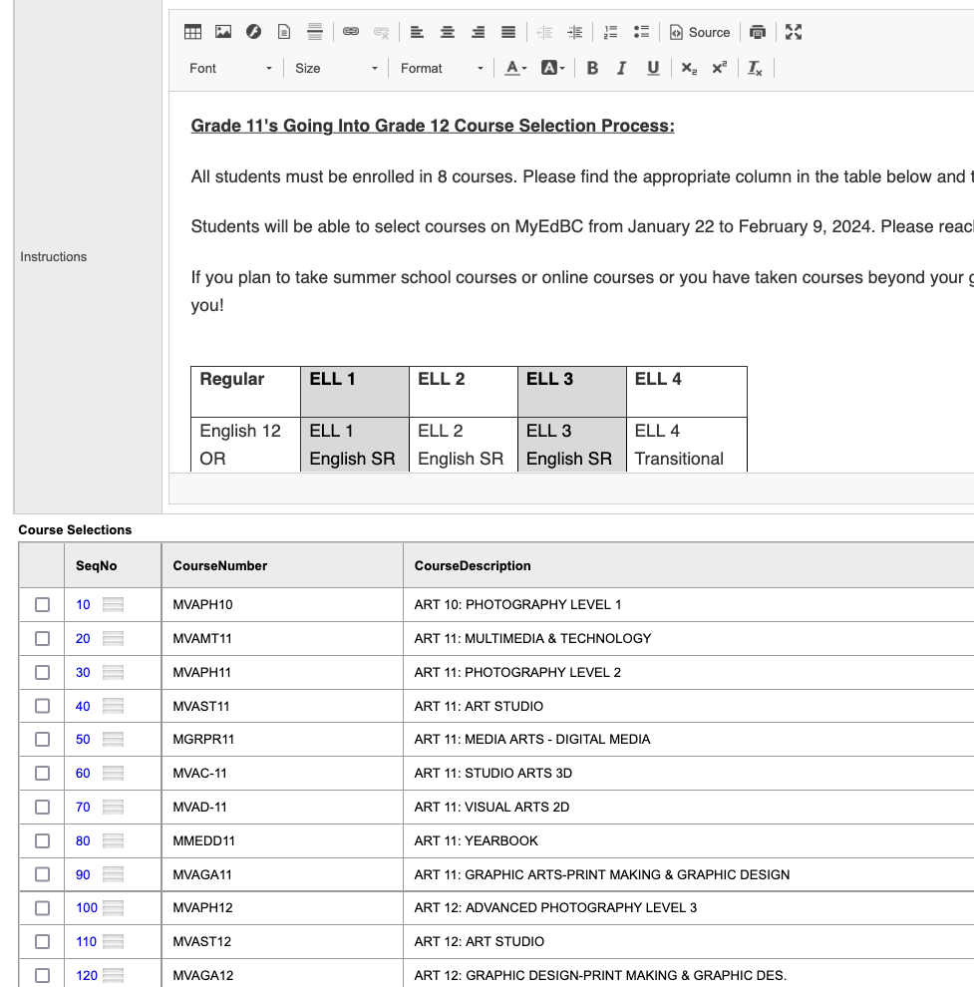
MyEducation Portal
OPENS: January 16 -February 17
Students must pick all 5 required courses and 3 elective courses (online).
*Use the Counsellors Notes section to communicate specific information such as summer school and online plans.
Notes:
Sample of pick list. USE COUNSELLORS NOTES for specific communication – including summer school and online plans
Great little chart in the INSTRUCTIONS section. Pay close attention and read it carefully. The chart will be a guide to how many courses and which required courses need to be included.

Slide 31
Monday January 26 & 27 @ 9:00 am in the Williams Lounge
Session 1: 9 - 9:30
Session 2: 9:30 - 10
Session 3: 10 - 10:30

Slide 32
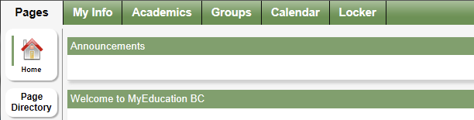
After logging in:
To enter your course selections, first select the “MyInfo” tab at the top of the page then click on the “Requests” tab on the left side

Slide 33
Once in MyEdBC, carefully read the home page instructions specific to your grade at the top of the page

Slide 34
ALTERNATE COURSES:
1. Not all students get the courses they request
2. Select alternates that you really don’t mind participating in.

Slide 35
Course Programming Order
Program planning presentation (today)
Learning what courses are available (through the course selection guide found online)
Ensure your MyEd password works prior to course selection day.
Course selection days Jan 26 & 27th in Williams Lounge
Course request verification forms will be sent
Opportunity to change requests will occur later in the spring.

Slide 36
THANK YOU VERY MUCH!

