Slide 1
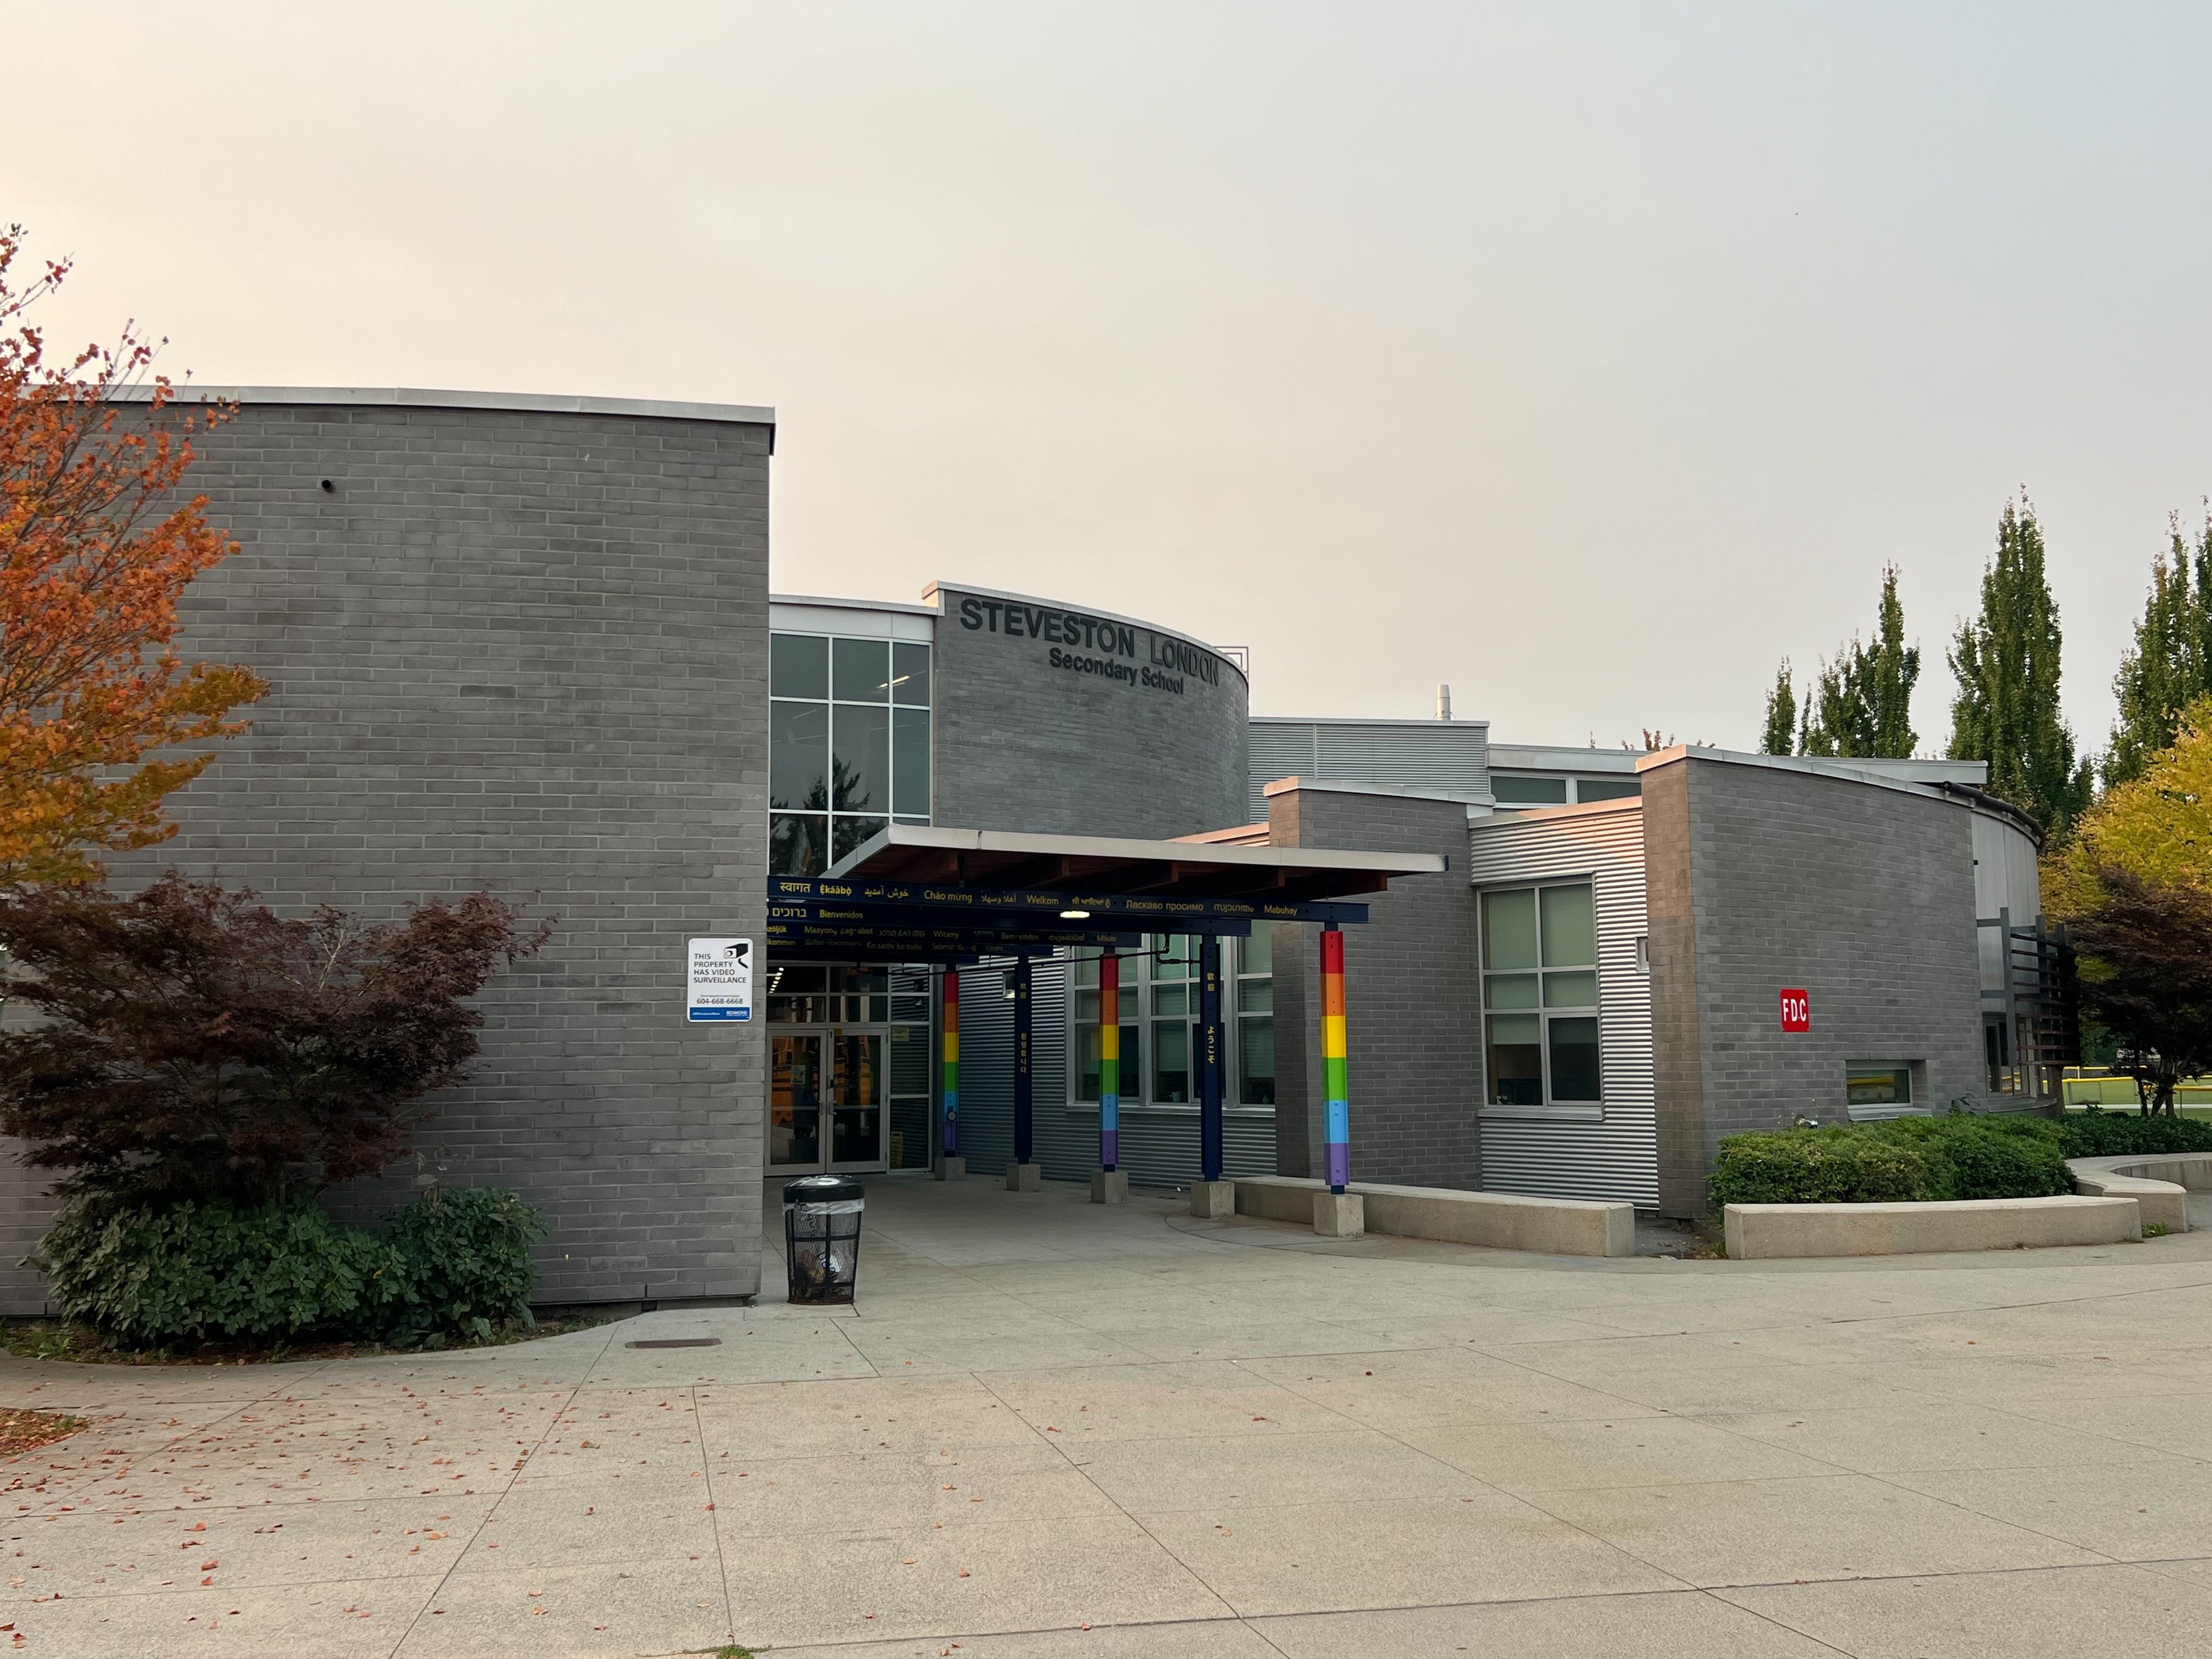



Steveston-London Secondary​
Grade 11 Program Planning
Webinar for Parents/Guardians
GRAD CLASS OF 2027
Notes:
Slide 1 – Title: Grade 11 Program Planning Webinar for Parents/Guardians (Grad Class of 2027)
Good evening, parents and guardians, and thank you for taking the time to join us tonight. We know that planning for Grade 12 and what comes after can feel overwhelming, and our goal this evening is to walk you through the process. By the end of this session, you will have more information about graduation requirements, course choices, timelines, and where to go for support. If there are any Grade 11s who missed their session this past Monday, tonight's session offers the same information so thank you to students who may be joining in with their parents or guardians tonight.

Slide 2
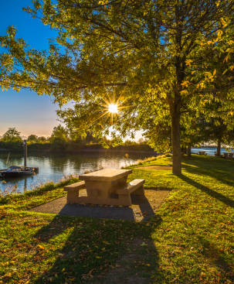
Land Acknowledgement
We acknowledge and thank the First Peoples of the hən̓q̓əmin̓əm̓ (hun-ki-meen-um) language group on whose traditional and unceded territories we teach, learn, and live.
As a settler who has spent my life on these lands, I hold a deep sense of gratitude for the place that has shaped me. I’m continually learning what it means to be a guest here, and I try to carry that awareness into my everyday life and into the way I talk with my own children about the responsibilities we share.
Notes:
Slide 2 – Land Acknowledgement
Script:
We acknowledge and thank the First Peoples of the hən̓q̓əmin̓əm̓ (hun-ki-meen-um) language group on whose traditional and unceded territories we teach, learn, and live.
As a settler who has spent my life on these lands, I hold a deep sense of gratitude for the place that has shaped me. I’m continually learning what it means to be a guest here, and I try to carry that awareness into my everyday life and into the way I talk with my own children about the responsibilities we share.

Slide 3


Curious about what courses to choose?
Make a strengths/interest inventory
Ask a friend/family/trusted adult for advice
You are creating your own pathway so be intentional with your planning
Notes:
Slide 3 – Curious about what courses to choose?
Script: A common question we hear from students and families is, “How do we know which courses to choose?” Tonight’s presentation is designed to answer that question by explaining requirements, options, and planning strategies that will help students make informed decisions for their Grade 12 year and beyond. Students can start by doing interest quizzes to understand their own strengths and career preferences. They could also ask others for advice. Everyone's path is different and would require individualized, thoughtful planning.

Slide 4
GRADUATION REQUIREMENTS
English (Creative Writing & Literary Studies) 10* English 11 English 12* Social Studies 10 Social Studies 11 or 12* Science 10 Science 11 or 12 Mathematics 10 Mathematics 11 or 12 Physical Health Education 10 Fine Arts or Applied Skills 10, 11, or 12 Career Life Education 10 Career Life Connections 12 Indigenous Education Requirement* | 2 credits & 2 credits 4 credits 4 credits 4 credits 4 credits 4 credits 4 credits 4 credits 4 credits 4 credits 4 credits 4 credits 4 credits
Required Courses | 52 Credits
Elective Courses | 28 credits
TOTAL OF 80 CREDITS
Notes:
Slide 4 – Graduation Requirements: Overview
Script: To graduate in British Columbia, students must complete a total of 80 credits. Each course is worth 4 credits, which means students must successfully complete 20 courses at the Grade 10, 11, or 12 level. These credits include both required courses and electives.

Slide 5
GRADUATION REQUIREMENTS
Students will need the following to graduate:
80 credits
Must be grade 10, 11, or 12 level courses
Each course is 4 credits
Totaling 20 courses
80 credits includes required courses and elective courses (a minimum of 4 courses (16 credits) at the Grade 12 level including English 12 and CLC 12)
Three Provincial Graduation Assessments:
Grade 10 Numeracy Assessment (GNA 10)
Grade 10 Literacy Assessment (GLA 10)
Grade 12 Literary Assessment (GLA 12)
Indigenous Education Requirement – all students will be required
to complete 4 credits of an Indigenous Focused course for graduation
Notes:
Slide 5 – Graduation Requirements: Details
Script: Of the 80 credits required, at least 16 credits must be at the Grade 12 level. These include English 12 and Career-Life Connections 12. Students must also complete three provincial graduation assessments: the Grade 10 Numeracy Assessment, the Grade 10 Literacy Assessment, and the Grade 12 Literacy Assessment. In addition, all students are required to complete 4 credits in an Indigenous-focused course as part of graduation requirements.

Slide 6
Course selection for your Grade 12 year Most students will have English FP 12 or English Studies 12 or AP English 12 as their ONLY required course. The other courses will be electives. If you haven’t completed requirements from previous years, e.g. CLE 10 or PHE 10, then you must select these courses.
Make sure you have the right courses for graduation
choose your courses carefully bASED ON YOUR FUTURE PLANS (WORK OR POST-SECONDARY)
TIMETABLE IS BUILT BASED ON STUDENT REQUESTS, SEATS IN CLASSES ARE NOT FIRST-COME-FIRST SERVE
Notes:
Slide 6 – Course Selection for Grade 12
Script: For most students, the only required course in Grade 12 is English—this may be English Studies 12, English First Peoples 12, or AP English 12. All other courses are electives, unless a student still needs to complete a requirement from a previous year, such as CLE 10 or Physical and Health Education 10. In those cases, those courses must be selected as part of your 8 courses for your timetable. Students need to choose their courses carefully based on their future plans whether they are heading into the workforce directly (or heading off to post-secondary). The timetable is built on student requests and is not first-come-first-serve. If a student does not request a course, a seat may not be available to them. Courses are run based on the number of requests, so please make informed decisions.

Slide 7
research
Be familiar with Education PlannerBC, attend info sessions at SLSS, talk to Ms. Digeso or your counsellor
general
admissions
Make sure you check official websites of post-secondary institutions for requirements, every institution is different
specific program
Make sure you have completed courses or planning to complete PRE-REQUISITES for your specific program of choice
Notes:
Slide 7 – Post-Secondary?
Script: Many students are beginning to think seriously about post-secondary pathways, whether that involves university, college, trades, or other training programs. It is important to consider post-secondary requirements when planning as programs are very competitive and each school will have different acceptance averages. Please check the post-secondary institution’s website for more details. They often offer open-houses, webinars and academic advising for students who are applying.

Slide 8











want to know more about
POST-SECONDARY?
Please contact Ms. Digeso, Career Information Advisor at: jdigeso@sd38.bc.ca
The Career Centre is open to students Monday through Thursday, 9:30am - 2:15pm
Students can book appointments directly with Ms. Digeso.
Please visit her office in the Counselling Centre.
Scan the QR code on her door to book an
appointment!
Notes:
Slide 8 – Career Centre Support
Script: For additional guidance, students are encouraged to connect with Ms. Digeso, our Career Information Advisor. The Career Centre is open Monday through Thursday, and students can book appointments directly using the QR code outside her office in the Counselling Centre. Ms. Digeso is an excellent resource for post-secondary planning and career exploration.

Slide 9
Online and summer school courses
Understand how online courses work
Strong organization skills, self-motivation and discipline to stay on track. Parents/guardians should be involved in the discussion of the appropriateness of the course
Be aware of online courses expectations for university admissions; some universities have strict requirements, e.g. Waterloo
Summer School – ce.sd38.bc.ca
Full credit courses are 6 weeks long in July
Registration begins in April/May
In-person summer school; max. two summer school courses
Richmond Virtual School – rvs.sd38.bc.ca
(semester, linear options)
Summer term requires 2 days of in-person classes a week)
Registration starts in February
Notes:
Slide 9 – Online and Summer School Courses
Script: Students considering online courses should take time to understand how they work. Online courses require strong organization and self-motivation, as there is no daily in-person reminder to stay on track. Are there other factors that may impact the student’s commitment to the course? If they are already taking 8 classes at school, taking additional online courses will add to a student's workload. Families should really discuss this at length to determine whether it is in their children's best interest to take online classes. If students do decide to take online courses, they cannot cross-enrol (meaning that they cannot take the same course at SLSS).
In addition, they should carefully review university admission deadlines and expectations for online courses. Waterloo, for instance, has strict guidelines around enrolling in summer school and online courses. Please check the university’s official website for more details.
For those interested in summer school registration, please visit their website at ce.sd38.bc.ca. Summer school courses are typically six weeks long in July, with registration opening in April or May. Students may take up to two summer school courses.
Richmond Virtual School provides hybrid online learning options for students. Their summer term requires 2 days of in-person classes per week and registration starts in February for the summer term. Please check their website rvs.sd38.bc.ca for more details.

Slide 10
TIMELINE
Choose your courses and enter them on myEdBC by February 17
It is important that you choose your courses carefully
Course Requests Verification: if you change your mind, you can request changes April 1-7
Only students with incomplete timetables or legitimate course errors will be allowed course corrections in September
Notes:
Slide 10 – Timeline (Key Dates at a Glance)
January–February: Course selection window
early April: changes can be requested if necessary
April-June: timetable is built according to requests
If students decide to take a course online or in the summer, they should inform their counsellor as these courses will not be a part of their 8 chosen courses at SLSS
We want to emphasize that students are not expected to have everything figured out right now. Course selection happens early in the calendar year, but students still have an opportunity to make changes in early April.

Slide 11

English
English Studies
English First Peoples
*Advanced Placement (AP) English Language and Composition (no longer includes First Peoples component)
*If you wish to take AP English, you must submit an application form, requires a reference from your English 11 teacher.
Deadline is Friday, March 6rd, 2026
Notes:
Slide 11 – English Options
Script: Grade 12 English options include English Studies 12, English First Peoples 12, and Advanced Placement English. Students interested in AP English should note that an application and a reference from their English 11 teacher are required, with a deadline of Friday, March 6, 2026. AP English is more demanding and is best suited for students who are prepared for a rigorous workload.

Slide 12
ADVANCED PLACEMENT COURSES
AP Calculus, AP Chemistry (Semester 2 only)
AP English Literature and Composition (Full Year, study block on alternate day)
Your AP scores could earn you first year level university or college credit (meaning you could skip certain courses in first year). Consider if you are ready to take first year level courses or if taking regular Grade 12 courses are more suitable
The material is more demanding of your time. You must go above and beyond in your efforts to study and perform well. Best to talk to respective subject teachers to get an opinion on whether the course is suited for you.
Recommended for studying abroad in the United States/England; doesn’t necessarily give you an advantage with post-secondary applications for Canadian schools
Notes:
Slide 12 – Advanced Placement Courses
Script: Advanced Placement courses such as AP Calculus, AP Chemistry, and AP English Literature offer students the opportunity to earn potential post-secondary credit. These courses are academically demanding and require a significant time commitment. They are often recommended for students considering study in the United States or the United Kingdom.

Slide 13


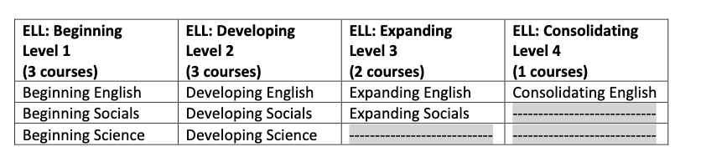
ELL
ELL meant to be a support block for learning English
Assume that you will be advancing (unless your teacher has told you otherwise)
The ELL department will update counsellors if there are any changes
Please see your ELL teacher if you have any questions
Notes:
Slide 13 – ELL Support
Script: ELL courses are designed as support blocks to help students continue developing English language skills. Students generally advance automatically unless advised otherwise by their teacher. Any changes will be communicated to counsellors, and students should speak directly with their ELL teacher if they have questions.

Slide 14




https://slss.sd38.bc.ca/students/program-planning
Talk to the teachers of the various electives that interest you.
Read course descriptions that are in the course planning guide.
What electives should I choose?
Talk to other students who have already taken the class
Look into different post-secondary programs and do some backwards planning from admissions requirements.
Talk to your counsellor or Ms. Digeso.
Try something new or something that you will not have access to after high school.
Notes:
Slide 14 – What electives should I choose?
Script: When choosing electives, students should speak with teachers, counsellors, and peers, review course descriptions, and consider post-secondary requirements. Grade 12 is also an opportunity to try courses that may not be available after high school or to explore new interests.

Slide 15
Should I take a study block?
Maximum TWO study blocks are available to you, usually one in each semester.
Questions to consider:
Am I on track to graduate? Talk to your counsellor.
Have met the pre-requisites for senior level courses for post-secondary applications?
Will I use my study block time wisely? Do I need two study blocks or will be okay with just one?
Do I have a rigorous schedule (balancing extra-curriculars with academics)?
Notes:
Slide 15 – Study Blocks
Script: Students may take up to two study blocks, usually one per semester. When deciding whether to include a study block, students should consider graduation progress, post-secondary prerequisites, time management skills, and overall course load, including extracurricular commitments.

Slide 16


Math & Social Studies
MATH
Foundations of Mathematics 12
Pre-Calculus 12
Calculus 12 (Semester 2,
pre-req: Pre-Calc 12)
AP Calculus 12 (Semester 2, pre-req: Pre-Calc 12)
SOCIALS
Physical Geography
Social Justice
20th Century World History
BC First Peoples
Law Studies

Slide 17

SCIENCES
Anatomy and Physiology 12
Chemistry 12
Geology 12
Physics 12
AP Chemistry (Semester 2,
pre-req: Chemistry 12)

Slide 18
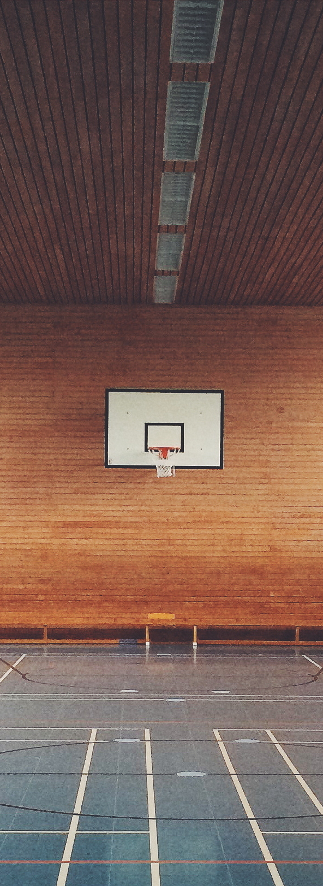
Physical Education
Active Living 12
Fitness & Conditioning 12
Athletic Leadership 12
Community Recreation 12
Fit for Life 12

Slide 19

FINE ARTS
VISUAL ARTS
Art Studio
Advanced Photography
Graphic Arts – Advanced Visual and Communication and Design
Digital Media Arts – Advanced Photoshop and Film Media
Yearbook
DRAMA
Theatre Production
Theatre Performance
Directed Studies
Directing and Script Development
MUSIC
Concert Band,
Vocal Ensemble,
Guitar,
Strings,
Recording Arts Technology

Slide 20

ADST (APPLIED DESIGN AND SKILLS TECHNOLOGY)
BUSINESS EDUCATION
Accounting
Financial Accounting 12 (for those who haven’t taken Accounting 11)
Economics
Computer Programming
Digital Communication Development
Marketing eCommerce
Work Experience (Accounting, Business, Law, Marketing
TECHNOLOGY ED
Drafting and Design
Metal Design
Transportation
Woodwork
HOME ECONOMICS
Food Studies
Textile Studies
Fashion Design

Slide 21


MODERN LANGUAGES
MANDARIN
12
JAPANESE
12
SPANISH
12
FRENCH
12
JAPANESE
INTRODUCTORY
11 (next step Japanese 11)
SPANISH INTRODUCTORY
11 (next step Spanish 11)
A second language is NOT required for graduation, but some university degree programs may have a language requirement.
A second language is NOT required for university application for UBC and SFU. For the Faculty of Arts at UBC, if you do take a Modern Language 12, they will look at the mark. Mandarin, Japanese, Spanish, French 12 are all courses that will be considered for admission at SFU.
Notes:
Slide 21 – Modern Languages
Script:
In our Modern Languages department, we offer Mandarin, Japanese, Spanish and French. For students who are new to Japanese and Spanish, they should take Introductory Japanese 11 or Introductory Spanish 11, which then leads into Japanese 11 or Spanish 11.
It is important to note that a second language is not required for graduation, but some university programs may have part of their degree requirements.
A second language is NOT required for university application for UBC and SFU. For the Faculty of Arts at UBC, if you do take a Modern Language 12, they will look at the mark. Mandarin, Japanese, Spanish, French 12 are all courses that will be considered for admission at SFU.

Slide 22
LANGUAGE PLACEMENT
For students who have not completed the Gr. 11 pre-requisite but have completed significant study in the target language outside of a regular SLSS class.
*must bring documentation of your learning (DELF certificates, Japanese and Chinese class report cards etc.
ASSESSMENT DATE: Thursday, Feb 5, 2026 during PLT
Mandarin
Japanese
French
Spanish
Ms. Gofsky
Room 300
Ms. Sybounmy
Room 400
Mme Munk
or Mme Lee
Room 302 or
Room 410
Ms. O’Neill
Room 101
Please sign up with the appropriate teacher on the PLT sign up page.
Notes:
Slide 22 – Language Placement
Script:
The Modern Languages department will be conducting placement evaluations on Thursday February 5 during PLT time for students who have not completed the Gr. 11 pre-requsite. These evaluations are for students who have prior knowledge of a language, this may include taking outside language courses, living in a country where the language is spoken, or speaking the language at home. This is not for students who are taking regular language courses at Steveston-London.
Students should be prepared to complete a placement assessment or have a conversation with the teacher to determine their appropriate language level for next year.

Slide 23
OFF TIMETABLE COURSES
Work Experience: Accounting, General Business, Law, Marketing
Athletic Leadership or Intramurals
Peer Tutoring (Teacher Assistant): not available if you already took this course in Gr. 11
Career Life Connections 12 (Connections class)
Continuing to work on your CAPSTONE! Required for Graduation along with your 30 hours of work/volunteer hours
Attend all Connections classes and Conference Days and follow timeline
Notes:
Slide 23 – Off-Timetable Courses
Script: Some courses take place outside the regular timetable. These options can provide flexibility but require strong organization and responsibility from students.
Please read the Program Planning Guide on the school’s website for more details.

Slide 24
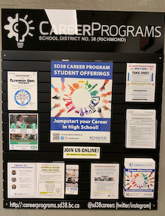
CAREER PROGRAMS
For more info, email: careerprograms@sd38.bc.ca
Career Programs board is located outside the Counselling Centre
Pick up a brochure and application
Notes:
Slide 24 – Career Programs
Script: The Richmond School District offers a variety of career programs that allow students to gain hands-on experience and industry-recognized training while still in high school. Information is available on the SD38 Career Programs website, and applications are required for many programs.

Slide 25




SD38 Career programs https://careerprograms.sd38.bc.ca/
Plumbing
Professional Cook
Aircraft Maintenance Engineer
Auto Collision Repair
Auto Finishing Prep Tech
Baking & Pastry Arts
Construction Electrician
Joinery
Masonry
Metal Fabrication
Millwright
Motorcycle Technician
Painting (Commercial)
Sheet Metal
Welding
Intro to Early Childhood
Education (ECE)

Slide 26

Royal Conservatory of Music
Drivers Education
you can earn
External Language Assessment
EXTERNAL CREDITS
Life Saving-
Bronze Cross
Language Challenge Exams
Instructor Level
First Aid
for certain
extra-curriculars
Some Provincial Sports Programs
Cadet Courses-
Air , Army, or Sea
Some National Sports Programs
Duke of Edinburgh’s
Award
Notes:
Slide 26 – External Credits
Script: Students may also earn graduation credits through approved external programs, such as music certifications, language assessments, first aid training, driver education, and certain sports or cadet programs.

Slide 27
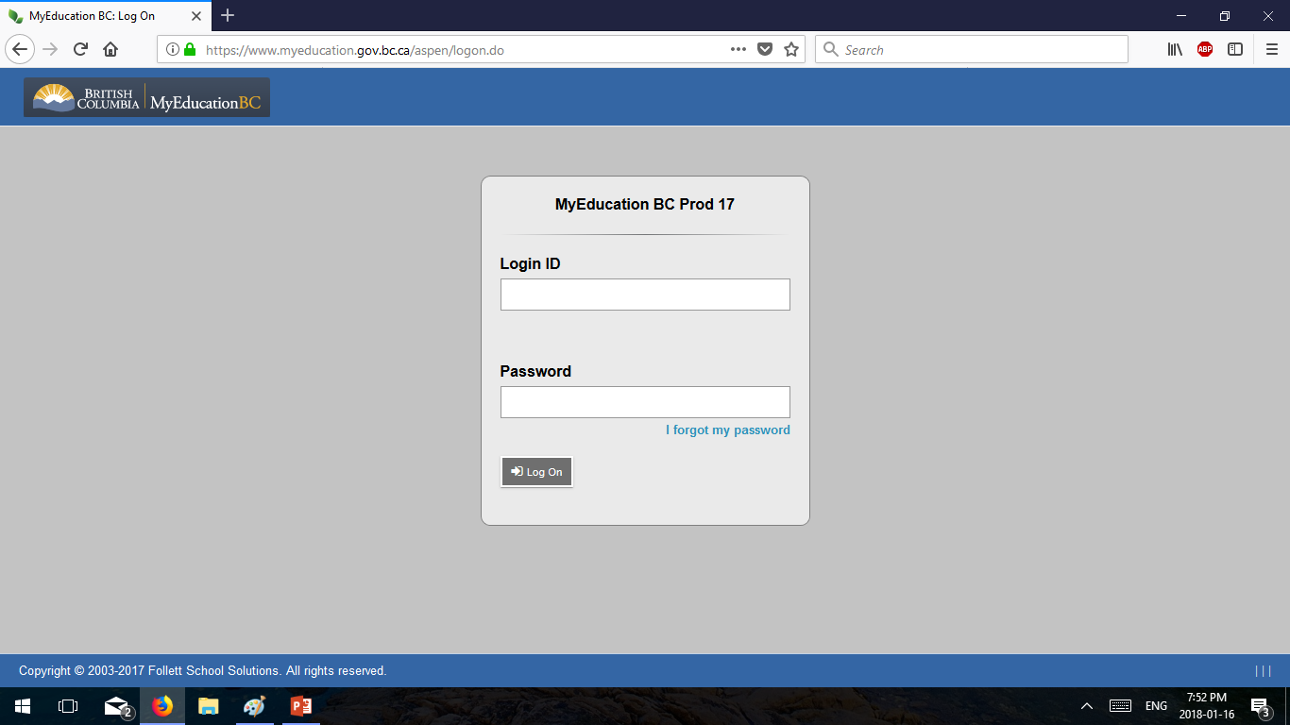
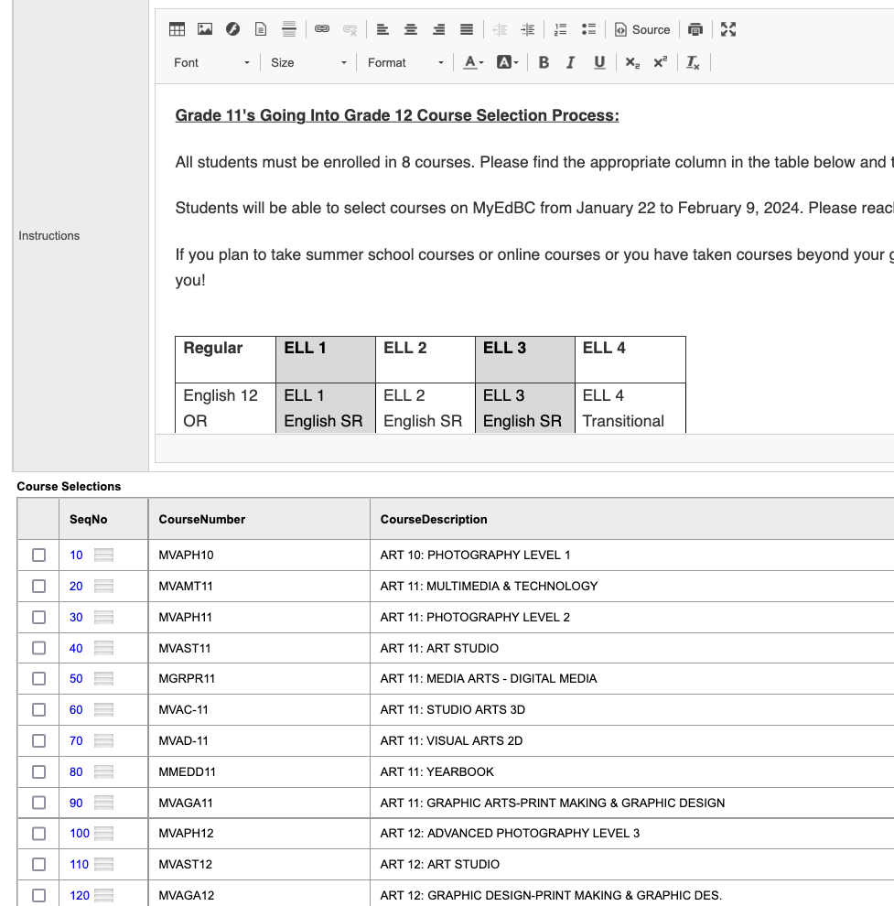
MyEd Portal opens
January 16th and closes February 17th
PICK 8 courses, which may include up to 2 study blocks
DO NOT include
CLC 12
*Use the Counsellors Notes section to communicate specific information such as summer school and online plans.
Notes:
Slide 28 – MyEd Portal
Script: The MyEd Portal opens on January 16 and closes on February 17. Students must select eight courses, which may include up to two study blocks. Career-Life Connections 12 should not be included. The counsellor notes section should be used to communicate summer school or online learning plans.

Slide 28
TIMELINE
Choose your courses and enter them on MyEdBC by February 17
It is important that you choose your courses carefully
Course Requests Verification: if you change your mind, you can request changes April 1-7
Only students with incomplete timetables or legitimate course errors will be allowed course corrections in September
Notes:
Slide 29 – Timeline
Script:
Here is a reminder of the timeline and action items, one of our previous slides.

Slide 29
COURSE CHANGES
→ Course changes occur at the beginning of each semester.
→ An online form is provided with a deadline for submission.
Students wanting to withdraw from courses past the withdrawal deadline:
“I’m struggling in my course and want to give up!”
Talk to your teacher, parent, school counsellor immediately when you are struggling in any course. DO NOT WAIT!
→ Have I done these?
Personal Learning Time (PLT) with your teacher. Communicate.
After school support (Science and Math)
Personal tutoring/study groups with friends
Come up with an action plan! Persist and don’t give up!
Notes:
Slide 30 – Course Changes & Student Support
Script:
I want to take a moment to talk about course changes and, just as importantly, what to do if a student is feeling overwhelmed or struggling.
Course changes can only happen at the beginning of each semester, and there is an online form with a clear deadline for submitting requests. We share this not to add pressure, but so families are aware of the process and timelines.
If a student finds themselves past the withdrawal deadline and thinking, “I’m struggling in this course and I just want to give up,” we want to be very clear and very supportive: they do not need to navigate that feeling alone. Struggling does not mean failure—it means it’s time to reach out.
We strongly encourage students to talk as soon as possible with a teacher, a parent or guardian, and their school counsellor. Early communication makes a real difference, and the sooner we know, the more options and support we can put in place.
Before giving up on a course, we ask students to reflect on a few key supports: Have they spoken with their teacher during Personal Learning Time? Have they accessed after-school support, particularly in subjects like Math or Science? Have they considered tutoring or studying with friends? And have they worked with an adult to create a clear, manageable action plan?
Grade 12 can be demanding, and challenges are a normal part of the learning process. With support, communication, and a plan, many students are able to work through difficulties successfully. We are here to help, and we want students to know that asking for help is a strength, not a setback.

Slide 30
POST-SECONDARY PLANNING WORKSHOP
In-person assembly for Gr. 11s interested in attending post-secondary
Date: Thursday March 5
Time: Lunch (1:10pm)
Location: Legends gym
Host: Ms. Digeso and Ms. Lau
Notes:
Slide 31 – Additional Program Planning Session
Script: For Gr. 11 students interested in post-secondary pathways, I strongly encourage them to attend this important assembly co-hosted by myself and Ms. Digeso, our Career Information Advisor.
The date is Thursday, March 5 at lunch in the Legends gym. Please arrive promptly as our time is limited. Ms. D and I decided to host this extra session to ensure that students are aware of the course requirements for post-secondary admissions.

Slide 31
MY SELF-CARE plan – how do I keep well?
What am I involved in outside of school?
Do I need to add or subtract from my schedule to be successful in my Grade 12 year?
Healthy eating
PHYSICAL ACTIVITY
Take breaks – rest & reset
Spend time with people who care about you
Find an opportunity to help someone else
Notes:
Slide 32 – My Self-Care Plan
Script:
I shared this slide with students earlier this week as a reminder of how important self-care and overall well-being are. I encourage you to take some time to talk with your future Grade 12 about how they can care for themselves and intentionally include wellness activities in their daily life.
Grade 12 can be an especially busy and sometimes stressful year and having a self-care plan can make a meaningful difference in helping students stay well and balanced. Self-care looks different for everyone, and there is no single “right” approach. I also want to acknowledge the important role parents and guardians play and encourage you to take care of your own well-being too.

Slide 32


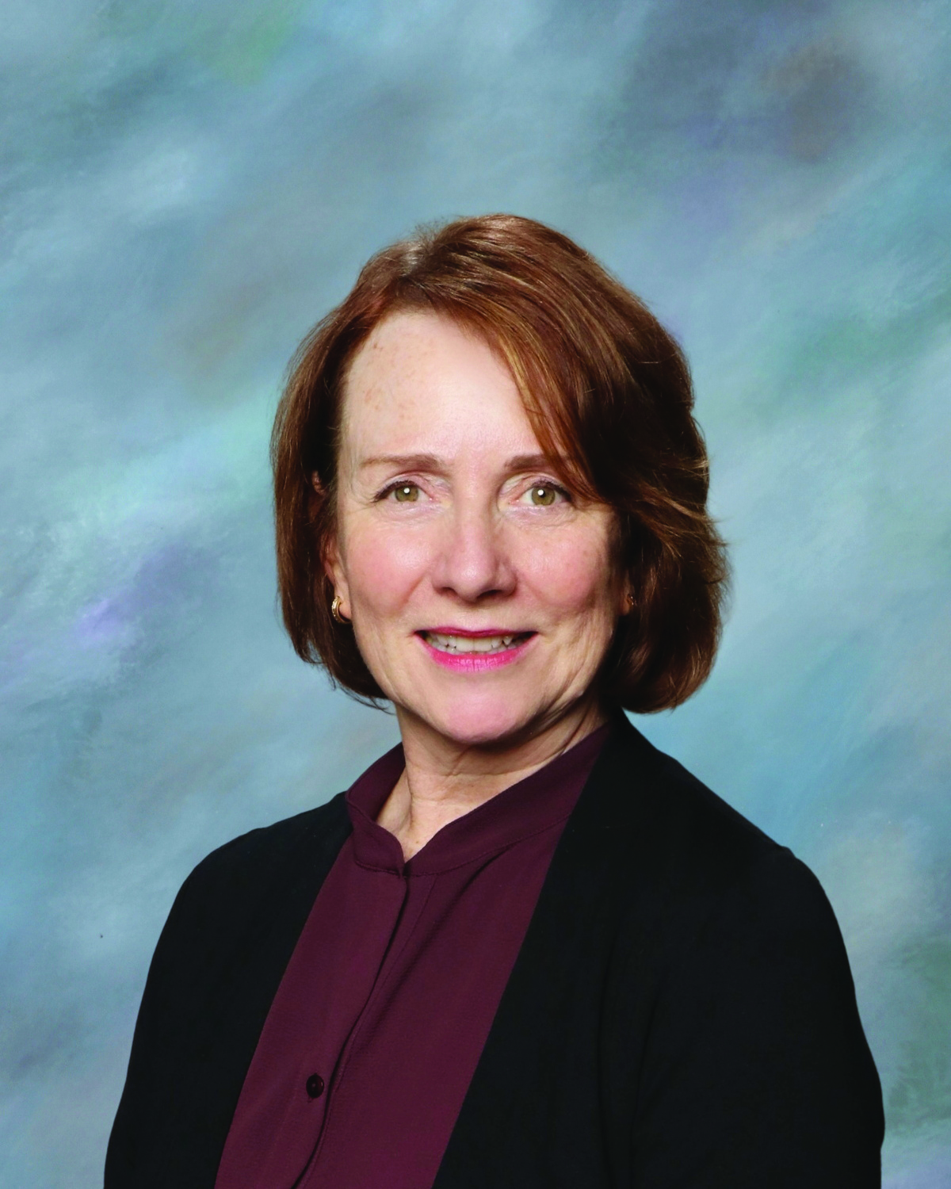
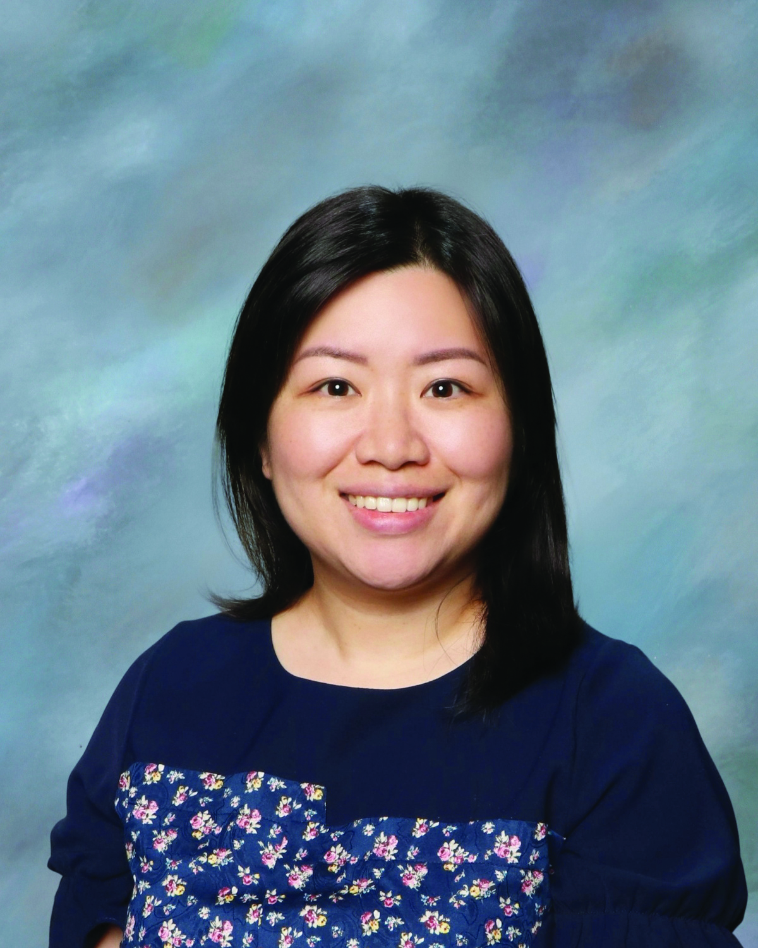
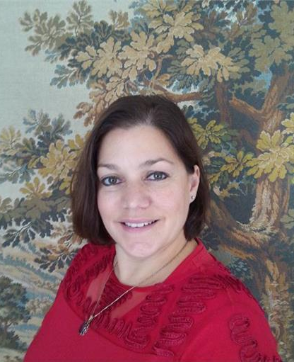
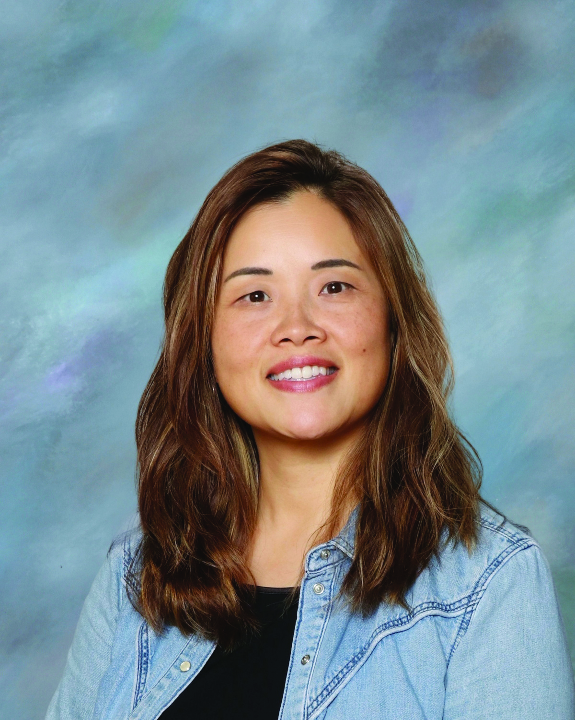
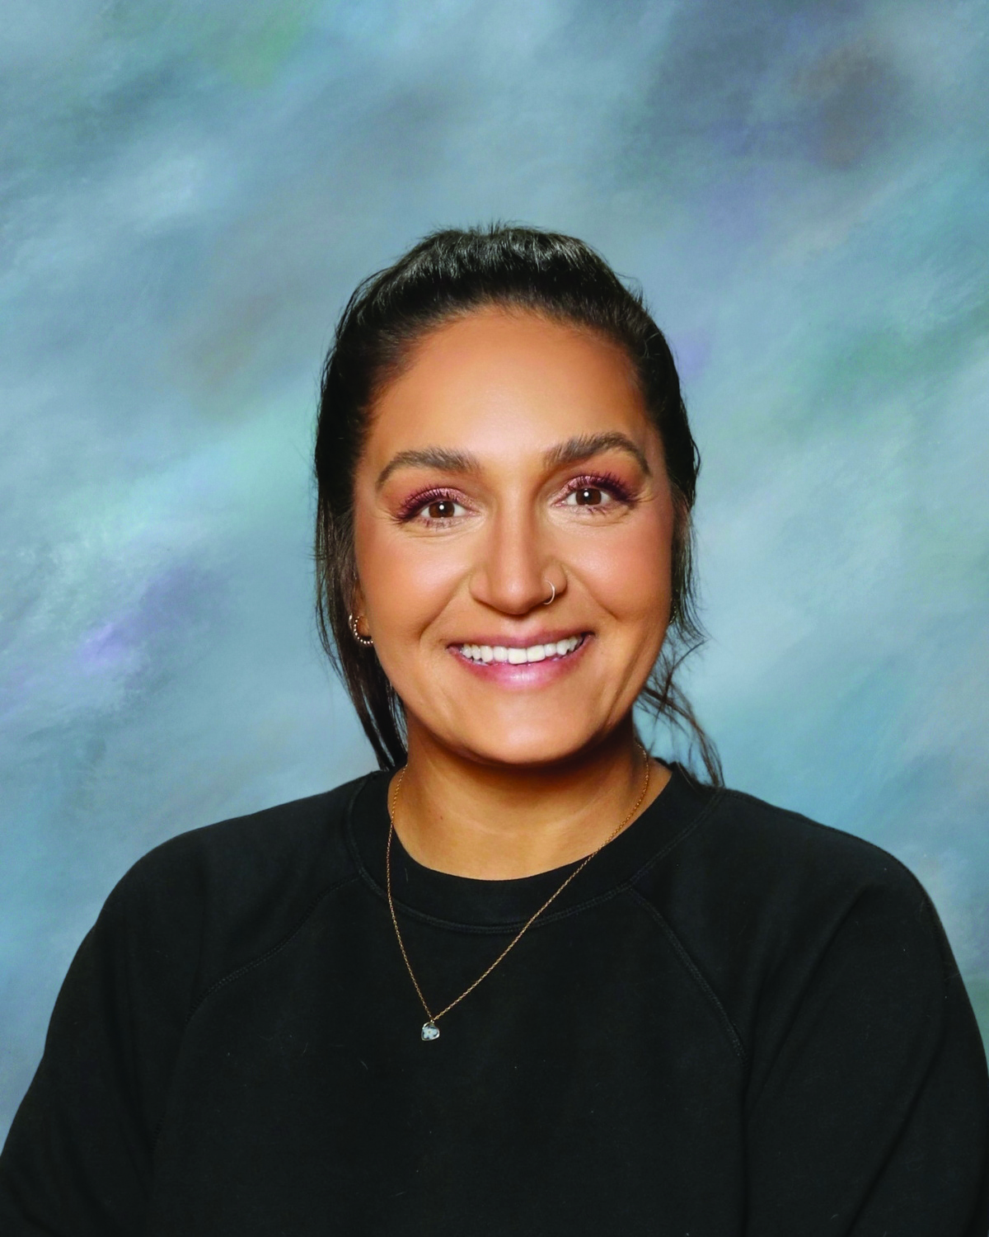
Students are at the heart of all we do.
COUNSELLING DEPARTMENT
Ms. Ratcliffe
Ms. Lau
Ms. Lau
Ms. Ioannidis
Ms. Zee
Ms. Sihota
A, X - Z
& International
B - G
B - G
H - J
K - O
P - W
Notes:
Slide 33 – Counselling Department
Script:
In closing, I just wanted to remind you that our counselling team is available to support students and families throughout the planning process. Counsellors are assigned alphabetically, and students are encouraged to reach out with questions or concerns via email or seeing their counsellor directly. Please remember that students are at the heart of all we do. We appreciate your partnership in supporting them as they plan for their final year of high school and beyond.
Thank you for your time this evening, and please do not hesitate to reach out to our counselling team or the Career Centre with any questions.

