Slide 1

Steveston-London Secondary School
GRADE 11
PROGRAM PLANNING
2026 - 2027

Slide 2
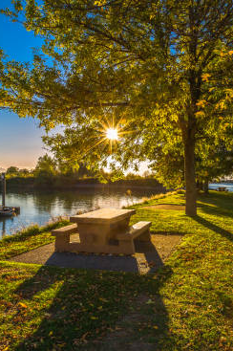
Land Acknowledgement
We acknowledge and thank the First Peoples of the hən̓q̓əmin̓əm̓ (hun-ki-meen-um) language group on whose traditional and unceded territories we teach, learn, and live.

Slide 3
Program Planning starts with….
YOU!
Make a strengths/interest inventory
Ask a friend/family/trusted adult for advice
You are creating your own pathway so be intentional with your planning

Slide 4
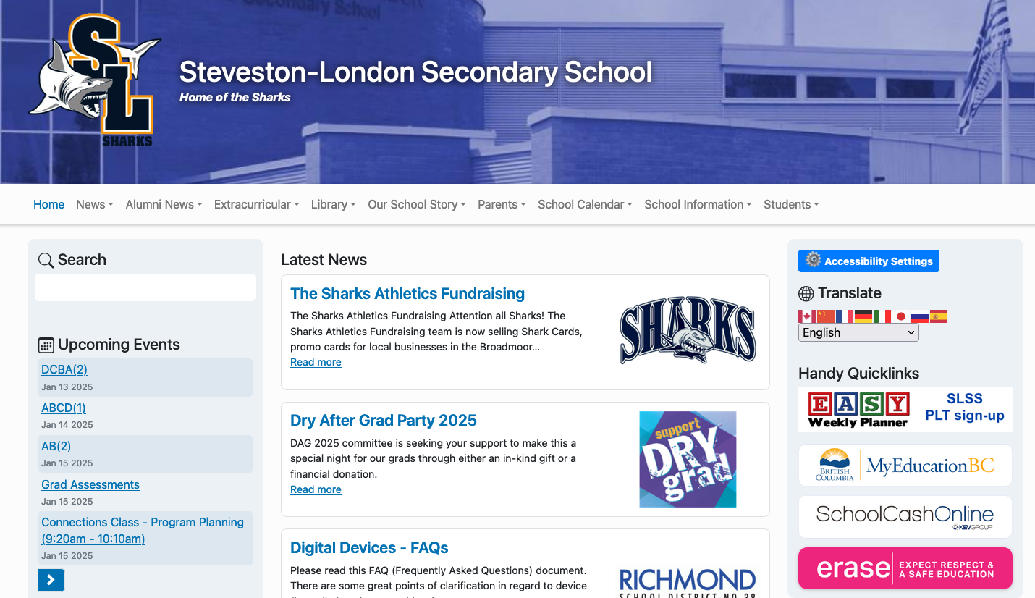
Where do I find course information?
*Program Planning Guide 2026/27*

Slide 5
GRADUATION REQUIREMENTS
Students need a minimum of 80 credits (20 courses) in Gr 10-12
There are 12 Required Courses:
>English 10 >Mathematics 10
>English 11 >Mathematics 11
>English 12 >Physical and Health Education 10
>Social Studies 10 >Career Life Education 10
>Social Studies 11 or 12 >Fine Arts/Applied Skills 10, 11, or 12
>Science 10 *At least 4 credits in Indigenous-focused coursework
>Science 11 or 12
7 Elective Courses (4 courses must be at the Grade 12 level)
Career Life Connections + Capstone (CLC 11 and 12)
Provincial Graduation Assessments: Numeracy 10, Literacy 10 and 12
How do I find out about electives?
>Talk to the teachers of the various electives and to your counsellor
>Talk to other students
>Read the Program Planning Guide
Notes:
UBC asks for a score of 3 on your GLA. 12

Slide 6
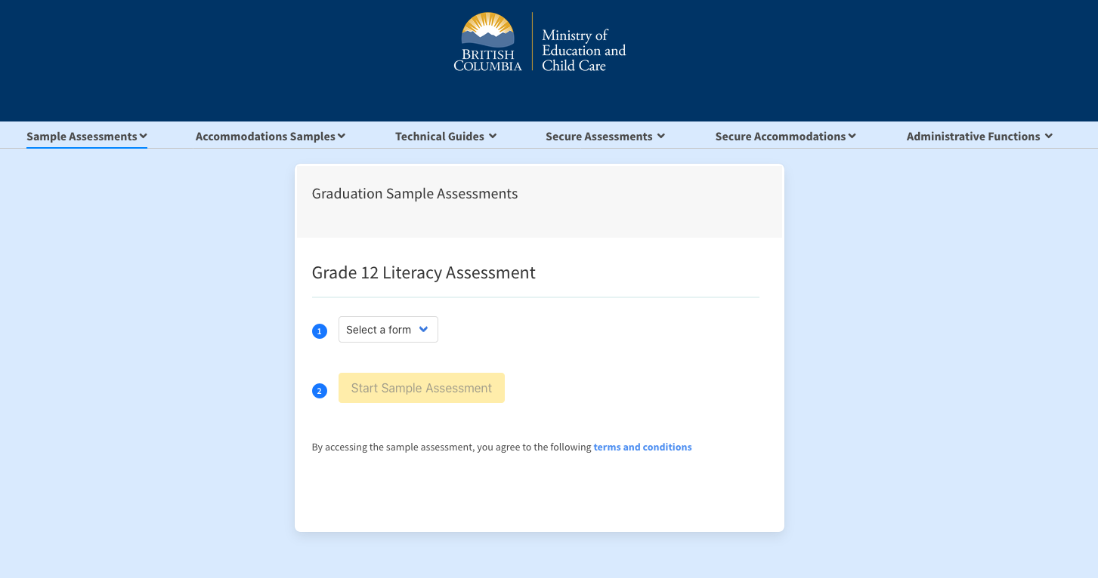
REQUIRED FOR GRADUATION
GRADUATION NUMERACY 10
LITERACY ASSESSMENTS 10/12
SAMPLES ON MINISTRY OF EDUCATION
WEBSITE FOR YOU TO VIEW
https://bced.vretta.com/#/en/bced-landing/grad/sample/literacy12
Notes:
TUTORIALS AVAILABLE ON website for all assessments, have a look!

Slide 7
Course selection
Make sure you have the right courses for graduation
It is important that you choose your courses carefully
Schools are staffed and timetabled according to the courses chosen by you
Only students with incomplete timetables or legitimate course errors will be allowed course corrections in September
LEGITIMATE Course Corrections
>You are registered in a course that you passed the previous year
>You are registered in a course that you passed in Summer School
>You have less than 8 courses
NOT a reason for course correction:
>Your friends aren’t in your class
>You don’t like the time of day the class is being offered
>You prefer another teacher

Slide 8
Course selection for post-secondary
research
Be familiar with MyEducation Planner, PSI websites, school info sessions at SLSS
admissions
Make sure you have completed courses required for ADMISSIONS
specific program
Make sure you have completed courses (PREREQUISITES) for your specific program of choice
six
Choose at least six Grade 12 senior level courses for your university application
Notes:
Evening event education planner is coming up - look out fro Ms Digeso’s emails!!!! Update your emails too!!!!
Apply in October of next year. It’s coming up!

Slide 9
Common reasons for a course drop
I changed my mind
I don’t need the course anymore
I realize the course is too difficult
I’ve changed my program of choice (again! It’s ok it happens!)
OH! I didn’t know that my program of choice did not require this course!
Notes:
I appreciate there may be things that are thrown at us in life, and that you may come across setback, difficulties. These are just a few. Life can be unpredictable, life circumstances may chance. Communicate with us!

Slide 10
Course change process
→ Course changes occur at the beginning of each semester.
→ An online form is provided with a deadline for submission.
“I’m struggling in my course and want to give up!”
Talk to your teacher, parent, school counsellor immediately when you are struggling in any course. DO NOT WAIT!!
Your participation in the problem solving is essential!
→ Have I done these?
  Personal Learning Time (PLT) with your teacher. Communicate.
  After school support (Science and Math)
  Personal tutoring/study groups with friends
  Come up with an action plan! Persist and don’t give up!

Slide 11
More tips! How to stay organized?
A suggestion! Create a new email account (separate from your personal life) for your post-secondary applications or for your job hunting!
ie. hellokitty123@awesome.com – may not be too professional!
Tour the campus of your liking in person or virtual! Be curious!
Financial Assistance and Student Loans are available! https://studentaidbc.ca.
What if I want to take a GAP year/break from school?
  Understand the DEFERRAL PROCESS for post-secondary schools
  You could study part time and work

Slide 12
Are Advanced placement (AP) courses for me?
Offered in the second semester of your Grade 12 year at SLSS:
AP Calculus, AP Chemistry and AP English Literature and Composition
Depends on your interest and goals: STEM or Language/Literature
Your AP scores could earn you college credit or advanced placement (meaning you could skip certain courses in college). Scores 3 or 4 are the target, but scoring lower will affect your GPA. Would it be better to get an ‘A’ in a non-AP course versus a ‘B’ in an AP course?
The material is more demanding of your time. You must go above and beyond in your efforts to study and perform well.
Recommended for study abroad in the United States.
Notes:
AP courses are college level courses done in high school. Students can take AP Exams at the end of the course. If you do well, you can earn college credit for that course!

Slide 13
EXTERNAL CREDITS
Royal Conservatory of Music
External Language Assessment
Language Challenge Exam
Athletics, Coaches, and Officials Programs
Life Saving – Bronze Cross
First Aid
Cadet Courses – Air, Army or Sea
Driver Education
Duke of Edinburgh’s Award
Notes:
This is the time to take stock of the many experiences, and community activities you have done. You can go to the Ministry of Education website to check whether your out of school experience would count for credit.

Slide 14

English
English Composition 11
English Composition Enriched 11 (NOT OFFERED 2026/27)
Notes:
Important course required for admissions to post-secondary – each school will have their minimum % expected. Aim to score higher than the minimum as programs are competitive

Slide 15


English language learning (ELL)
  Assume that you will be advancing (unless your teacher has told you otherwise)
  The ELL department will update counsellors if there are any changes
  Please see your ELL teacher if you have any questions

Slide 16

FINE ARTS
  ART – Art Studio, Photography, Graphic Arts, Multimedia and Technology,
  Visual Arts 2D, Studio Arts 3D, Yearbook
  DRAMA – Theatre Production and Performance, Directed Studies, Directing and Script Development
  MUSIC – Concert Band, Vocal Ensemble, Guitar, Strings, Recording Arts Technology

Slide 17

Applied skills
  BUSINESS EDUCATION
  Accounting
  Financial Accounting
  Economics
  Computer Programming
  Digital Communication
  Marketing
  Work Experience (Accounting, Gen Business, Law, Marketing
  TECHNOLOGY
  Drafting and Design
  Metal Design
  Transportation (NOT OFFERED 2026/27)
  Woodwork
  HOME ECONOMICS
  Food Studies
  Textile Studies
  Fashion Design 12

Slide 18
Modern languages
French
Japanese and Japanese Intro 11
Mandarin
Spanish and Spanish Intro 11

Slide 19

Language placement assessment
Thursday, February 5th – PLT sign up
  Ms. Gofsky (Mandarin)
  Mme. Munk (French)
  Ms. Sybounmy (Japanese)
  Ms O’Neill (Spanish)
Notes:
These evaluations are for students who have prior knowledge of a language, this may include taking outside language courses, living in a country where the language is spoken, or speaking the language at home. This is NOT for students who are taking regular language courses at Steveston-London. You will be asked to complete a placement test or have a conversation with the teacher to determine your appropriate language level for next year. If you have taken a formal course in the language, please bring all your documentation showing this.

Slide 20
Second language requirements
A second language is NOT required for graduation
A second language is NOT required for university application for UBC and SFU.
Language Challenge Exam
**Consider taking a Language 12 if you are applying into the Arts Faculty
Notes:
A good recommendation to take up to a Grade 12 foreign language. Some Faculty of Arts will ask students to take a year 1 language, if they do not have a Gr 12 language. It would be a great idea to take a Language 12 here!
Language Challenge Exam is offered through the Delta school district. If you are fluent in another language other than English, you may want to explore this option. If you’d like to know more, visit the website as well as come talk to your counsellor.

Slide 21
Physical Education
Physical Education 11: Active Living
Fitness & Conditioning 11
Athletic Leadership 11
Community Recreation 11
Fit for Life 11
(previously FemFit 11)
Notes:
Kinesiology, PE teacher, sports psychologist

Slide 22

Math & social studies
Foundations of Mathematics 11
Pre-Calculus 11
Workplace Math 11
Social Justice 12
20th Century World History 12
BC First Peoples 12
Law Studies 12
Physical Geography 12
Notes:
AP Calculus and Calculus 12 are offered in the second semester of your gr 12 year. Do review if you have not been in a math class since Gr 11
Have you chosen a course with Indigenous Education content?

Slide 23
Sciences
Life Sciences 11
Chemistry 11
Physics 11
Earth Science 11

Slide 24
Off timetable courses
Athletic Leadership or Intramurals (Full year)
Peer Tutoring (Teacher Assistant): available once in Gr 11 or 12
Career Life Connections 11
Work towards CAPSTONE. Required for Graduation!
Attend all Connections classes and Conference Days
Notes:
On the online course selection, please specific in the COUNSELLOR’S NOTES that you want INTRAMURALS.

Slide 25
Online and summer school courses
Understand how online courses work! Am I a motivated and organized learner to keep myself on track? (No one will chase me down!) Ask a trusted adult/parent before registering.
Summer School – Richmond Continuing Education website.
Full credit in person courses are 6 weeks long in July.
  Registration begins in April.
In Person summer school is at two sites in Richmond (AM and PM options)
You can take up to two summer school courses
Online Summer and In-Person School available with Richmond Virtual School
NOTE: Study blocks are not provided if are you are taking an online class.
Notes:
Online courses are designed to provide flexibility for the learner. You might find yourself traveling in the summer, and maybe online would be a good fit.

Slide 26
Distance learning (online)
Choose a recommended online school ie. Richmond Virtual School
You are adding another course on top of your Gr 11 Full time Schedule ie. You will have 9 courses to manage
You are responsible for making sure your mark is accurate on your transcript and reported on time
Questions to consider:
Am I motivated and independent to stay on top of my online learning?
Do I have time in my schedule afterschool and weekends to work on my online course? Do I have extra curricular activities and family time to consider?
Do I have a rigorous schedule?

Slide 27




SD38 Career programs https://careerprograms.sd38.bc.ca/
Plumbing
Professional Cook
Aircraft Maintenance Engineer
Auto Collision Repair
Auto Finishing Prep Tech
Baking & Pastry Arts
Construction Electrician
Joinery
Masonry
Metal Fabrication
Millwright
Motorcycle Technician
Painting (Commercial)
Sheet Metal
Welding
Intro to Early Childhood Education (ECE)
Health Care/Dual Credit courses: Intro to Biomedical & Health Sciences, Intro to Health Sciences 1115
KPU Strive
LinK38 partnership with Kwantlen University (dual credit for high school and university)

Slide 28

WANT TO KNOW MORE ABOUT POST-SECONDARY?
CAREER CENTRE
Ms. Digeso: jdigeso@sd38.bc.ca
Career Centre Hours:
Monday - Tuesday 10:30am to 3:00pm
Wednesday –Thursday 9:30am to 2:00pm.
Notes:
I love that it is central and a part of our Counselling Center.

Slide 29
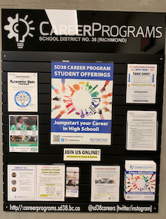
Career programs board
careerprograms@sd38.bc.ca
Career Programs board is located outside the Counselling Centre.
Pick up a brochure and application.

Slide 30
More tips! How to stay organized?
focus on strong organization – get your notes, assignments in order early on.
develop consistent study habits (previewing lessons) – study ahead!
manage your time effectively – use techniques like 45 min study/15 min break, avoid cramming – it doesn’t work!
set clear academic/career goals – define what you want to achieve academically and for your future. See your counsellor and career advisor!
seek help early – don’t wait!
prioritize your well-being to handle increased workload and avoid burnout, remembering that Grade 11 sets the stage for future success.

Slide 31
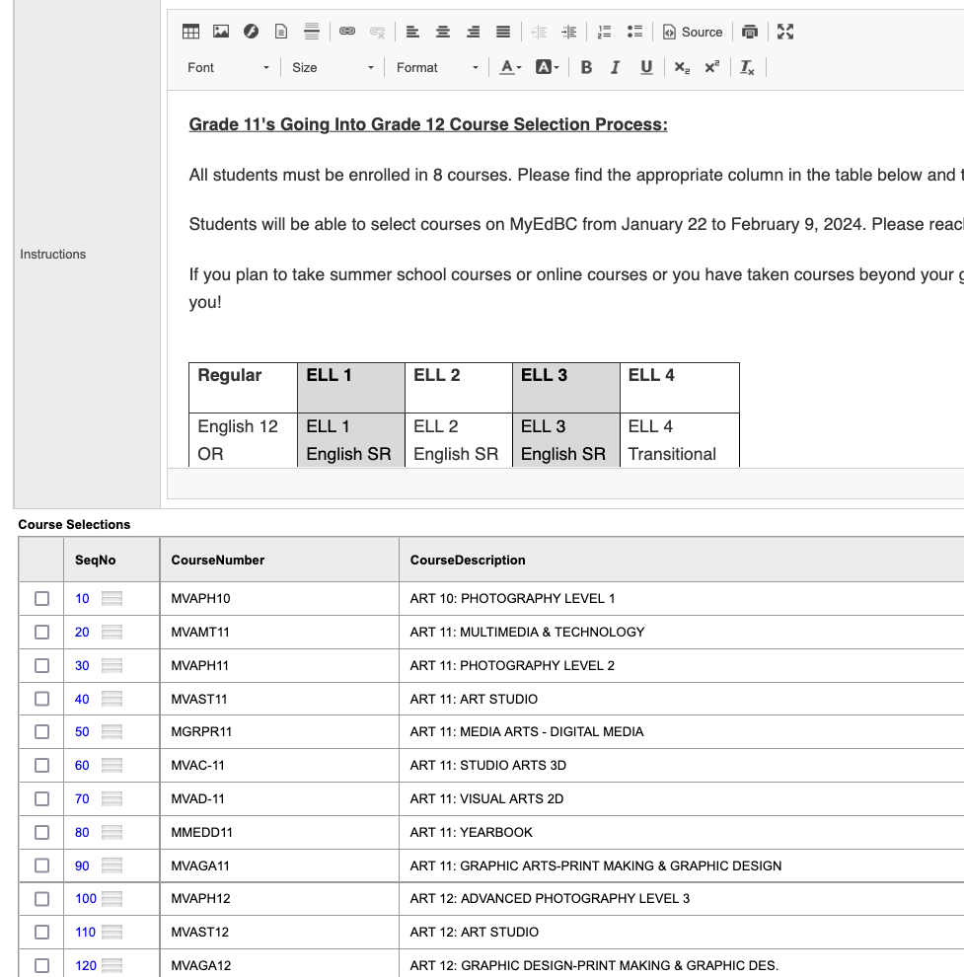
UPDATE login details for MyEducation Portal login
PICK 8 COURSES, which may include your Learning Strategies/ELL
DO NOT include CLC 11
*Use the Counsellors Notes section to communicate specific information.
Notes:
Sample of pick list. USE COUNSELLORS NOTES for specific communication – including summer school and online plans
Great little chart in the INSTRUCTIONS section. Pay close attention and read it carefully. The chart will be a guide to how many courses and which required courses need to be included.

Slide 32
Webinar
Parent program planning
Thursday, January 15, 6:00pm
MyEducation BC website
course selection opens
January 16 - February 17, 2026

Slide 33



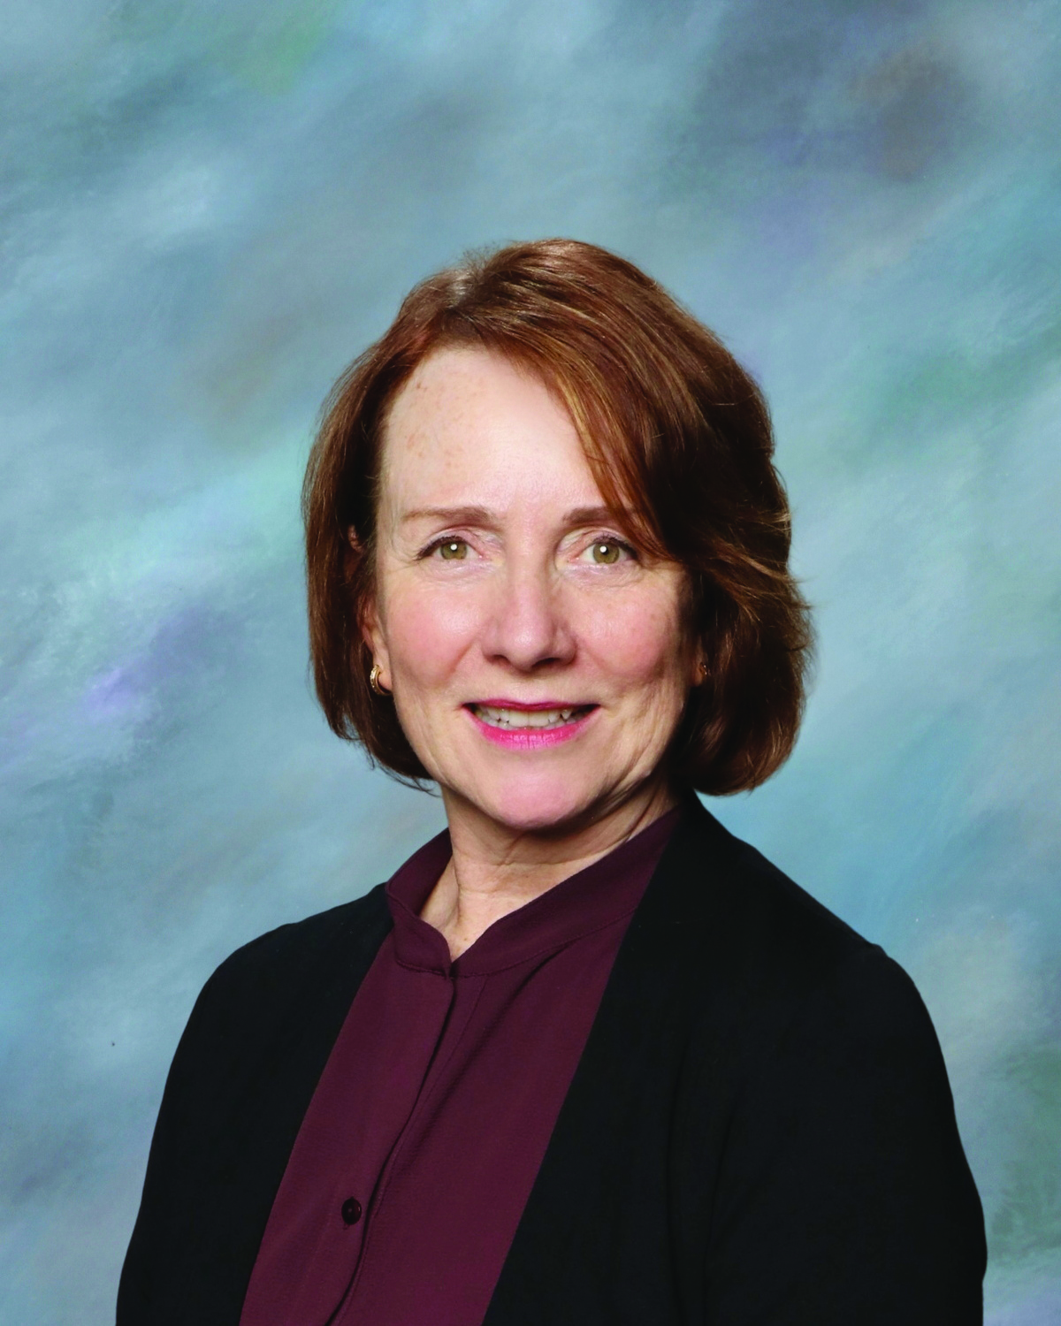
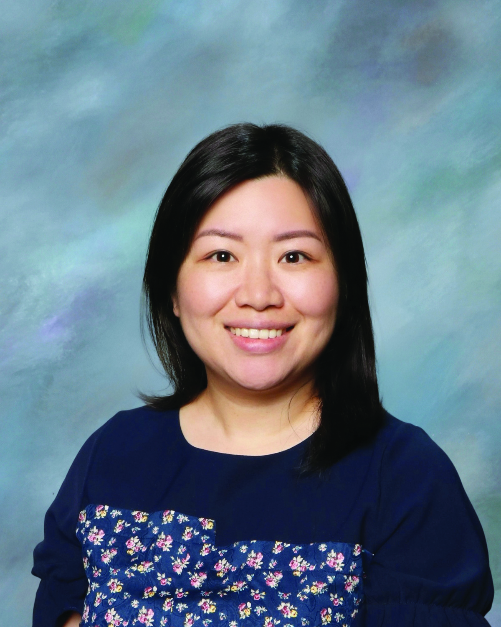
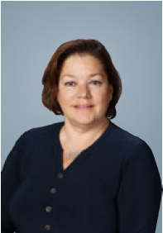
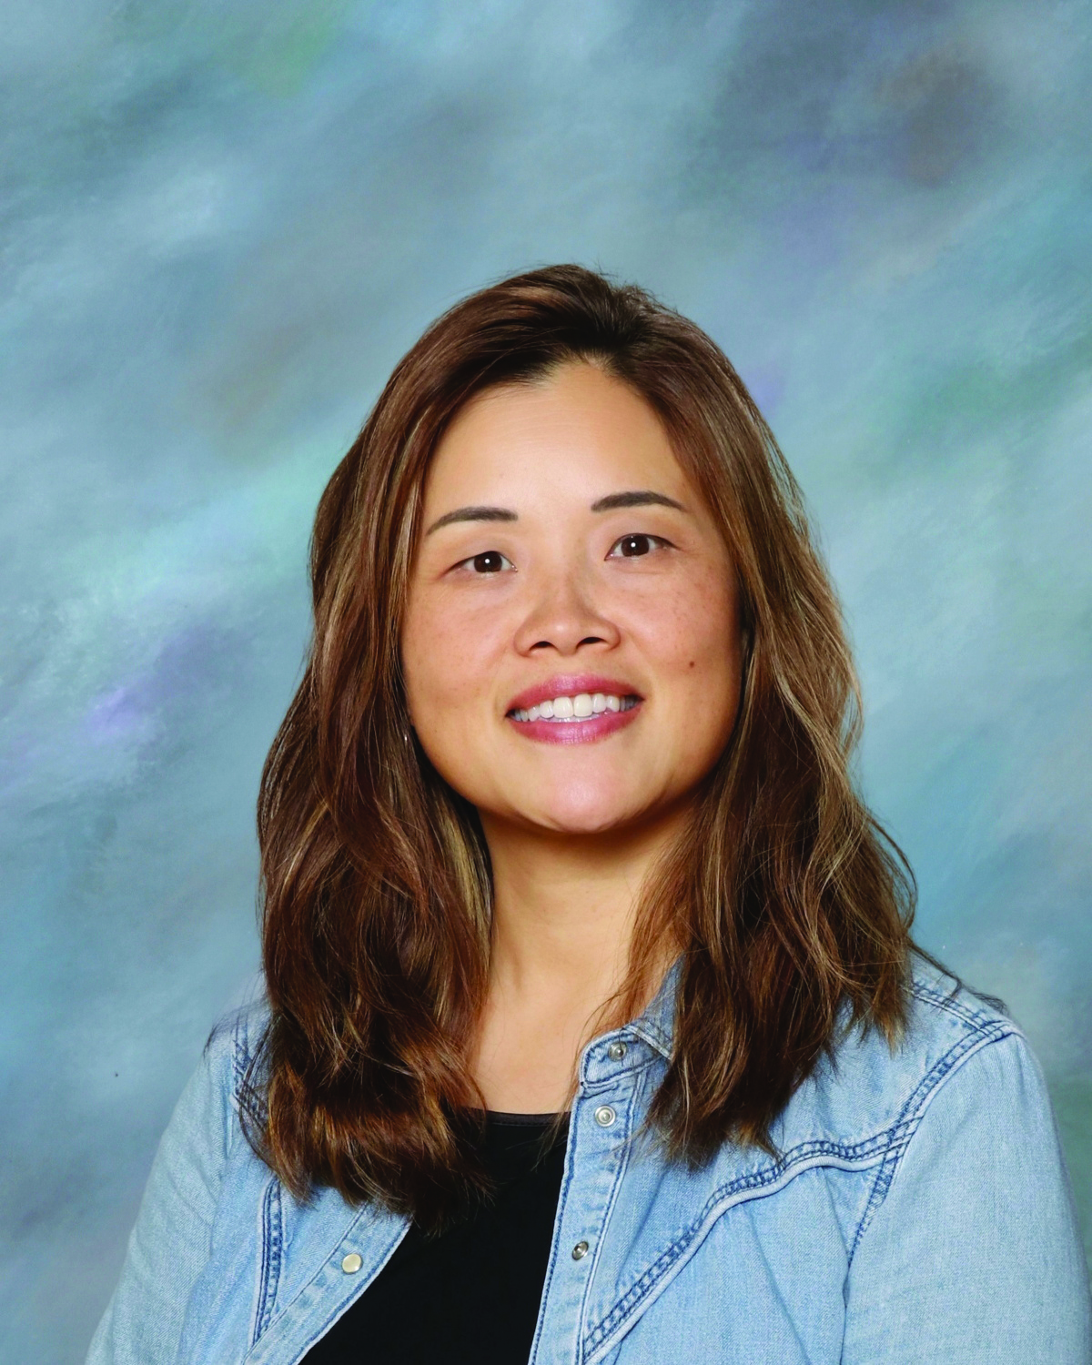
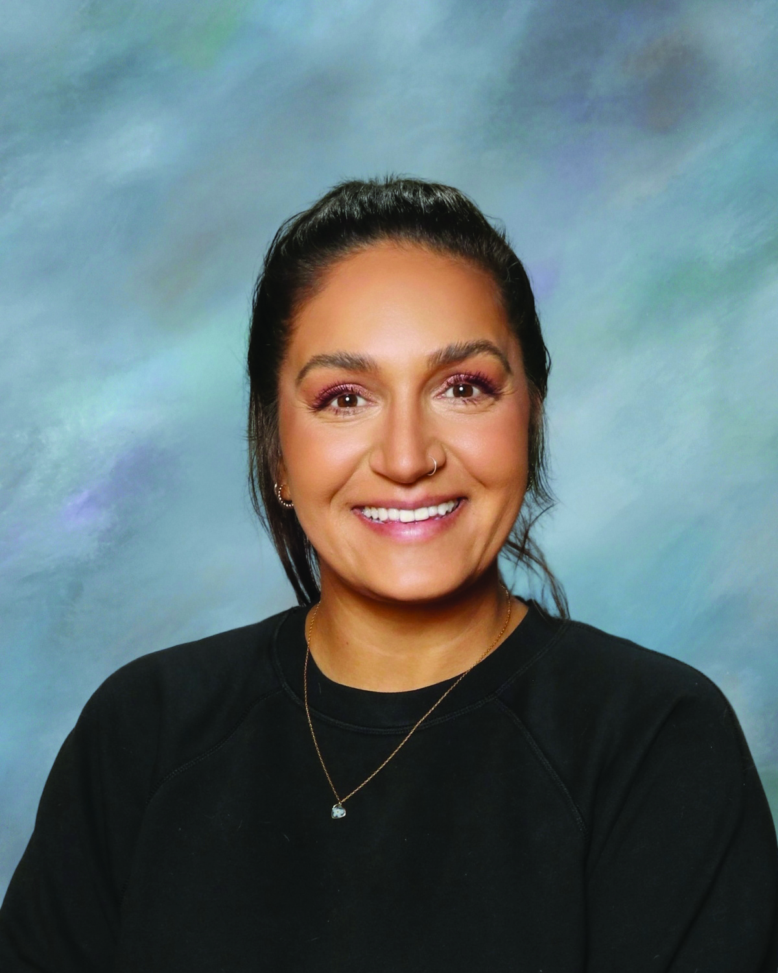

Student Support Services
COUNSELLING DEPARTMENT
Ms. Ratcliffe
Ms. Lau
Ms. Lau
Ms. Ioannidis
Ms. Zee
Ms. Sihota
A, X - Z
& International
B - G
B - G
H - J
K - O
P - W
Notes:
Katrina

